Slide 1
Crafting the truth: Narrative as the Rhetorical glue between research, argument, and creative nonfiction
Shanetia Clark: Salisbury State University
Jason Griffith: Arizona State university
Alex Corbitt: New York City Dept. of ed.
Cindy Minnich: upper dauphin area high school, Pa

Slide 2
2-Minute Writing activity
What were you doing this morning at approximately 8:01AM? Write a brief and active scene demonstrating your 8:01.

Slide 3
Twitter backchannel
Comments, questions, ideas, resources? Please tweet them using:
#craftingtruth #ncte15
Shanetia: @uvagradu8
Jason: @JGriff_Teach
Alex: @Alex_Corbitt
Cindy: @CBethM
www.breathedeepandteach.com

Slide 4
From Me to we: broadening millennial minds with creative nonfiction
Jason Griffith, ASU
Millennials… selfish?
Literary landscape: Malala, serial podcast, nonfiction book to film pipeline (Unbroken, wild, theory of everything, the imitation game, American sniper)
Common Core: teach literary nonfiction + More informational text
Unit: read a narrative nonfiction core text, write a personal essay.
Resources: 2 Must Haves: Minds Made for Stories (newkirk) and You can’t make this stuff up (gutkind)
Share: 2x 8:01 stories

Slide 5
Lesson 1: Write your truth
Activity: Perspective walk

Slide 6
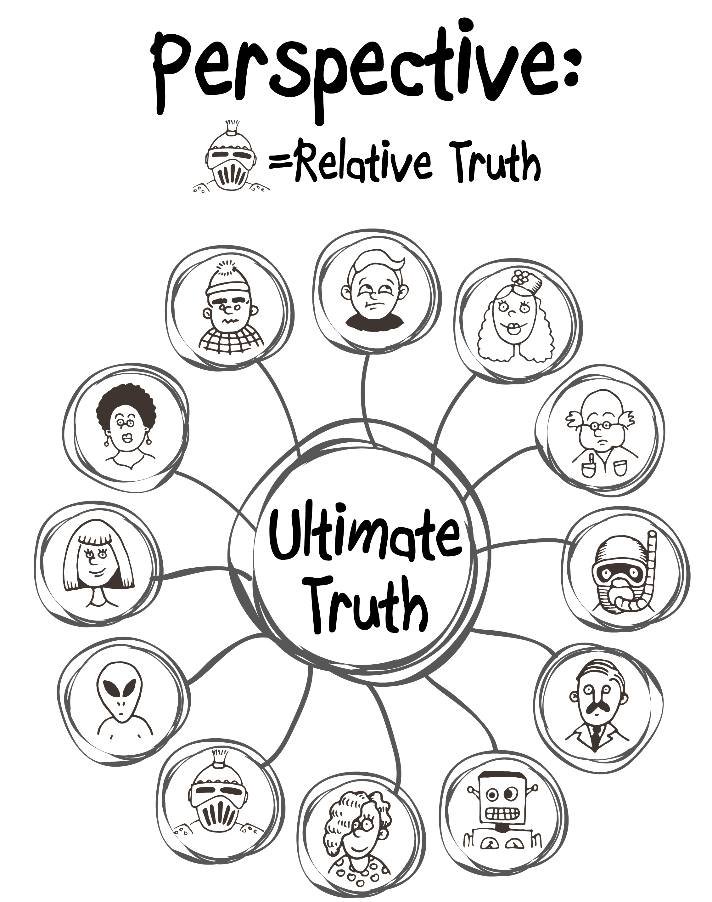

Slide 7
Writing activity: make a T-chart
3 Interesting people
Interesting characteristics
Shanetia
Cindy
Alex
Kind, funny
Thoughtful, thinks outside the box
Menacing, something dark that I can’t quite put my finger on

Slide 8
Lesson 2: Build the reservoir activities: listing, responding to prompts, mining social media

Slide 9
(Hypothetical) writing activity
(imagine we had time)
Choose one of your interesting people from your list
Write a brief, active scene which shows the interesting person demonstrating the interesting characteristic

Slide 10
Lesson 3: put the reader in your shoes
Activities: write in scenes (action, dialogue, active verbs)

Slide 11
Lesson 4: frame it right.
Activities: evaluating first lines.

Slide 12
Evaluating first lines
I’ll read to you the title and first line of an essay.
Rank it from 1-5 (1= least interesting, 5= most interesting)
Now, listen to the rest of the opening paragraph.
Thumbs up if interest goes up, thumbs down if it goes down.

Slide 13
Famous last words: Good advice for last lines
Jane Bernstein:
  The unspoken last line of a personal essay should be:
  “And nothing was the same after that.”

Slide 14
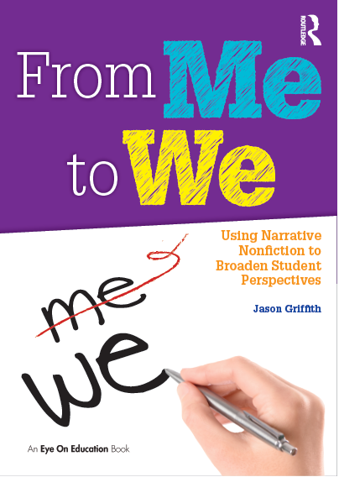
Coming late spring 2016 from routledge Eye on education:

