Slide 1
Examining Truth:
Reading and Writing the New Nonfiction
Jason Griffith @JGriff_Teach
Arizona State University
#humanitiesrock

Slide 2
How many truths are there?
Notes:
Presenter introduction – this is your “traveling time” to the podium.

Slide 3
Opening Activity
Write for 5 minutes.
  Active Scene
    Beginning and an end
    Action, dialogue, and active verbs… make it happen.
    Think of the structure of a single movie scene
  Don’t make it up.
    Try to capture a moment of what really happened and write it in an interesting way.
Prompt: Write the story of your 12:15 PM.

Slide 4
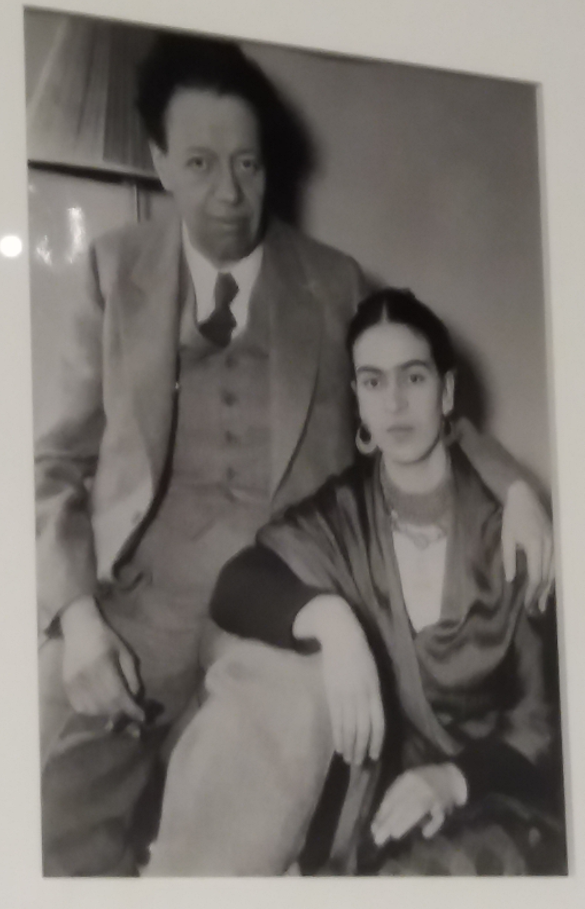
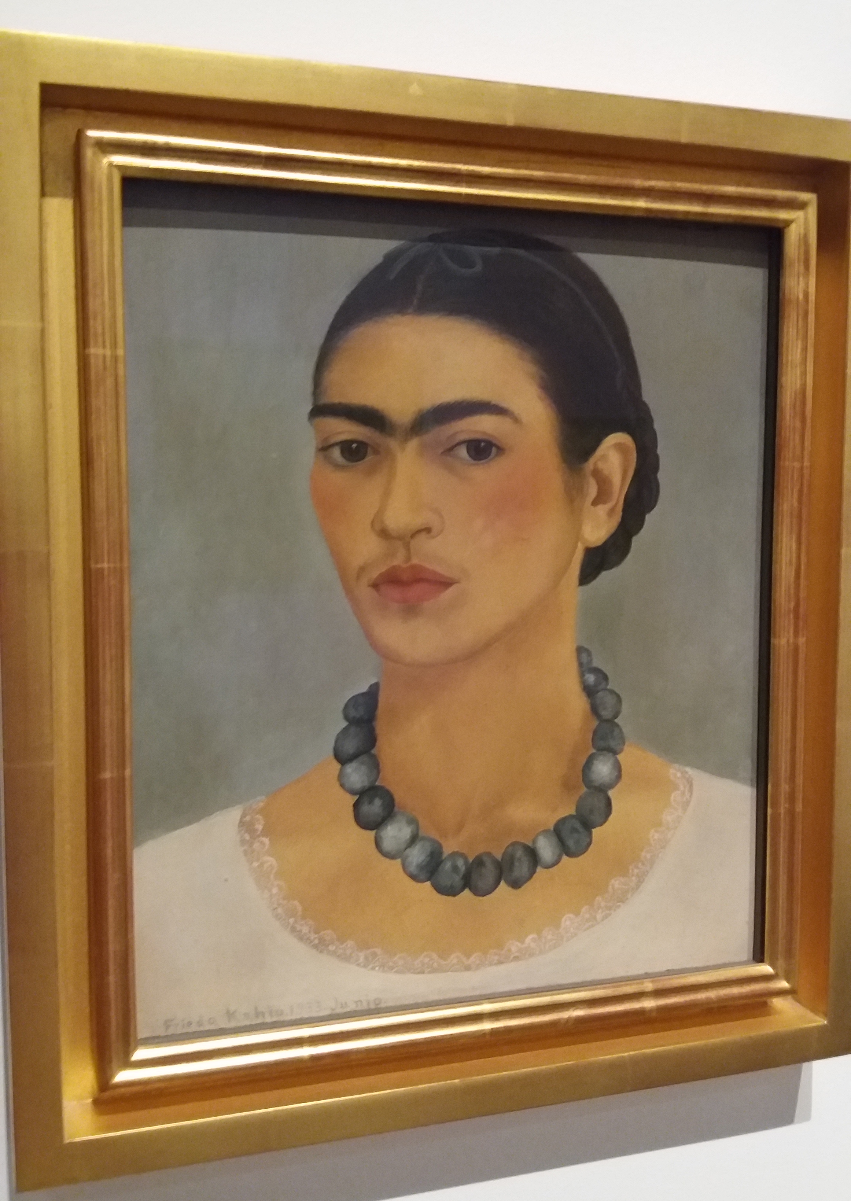

Slide 5
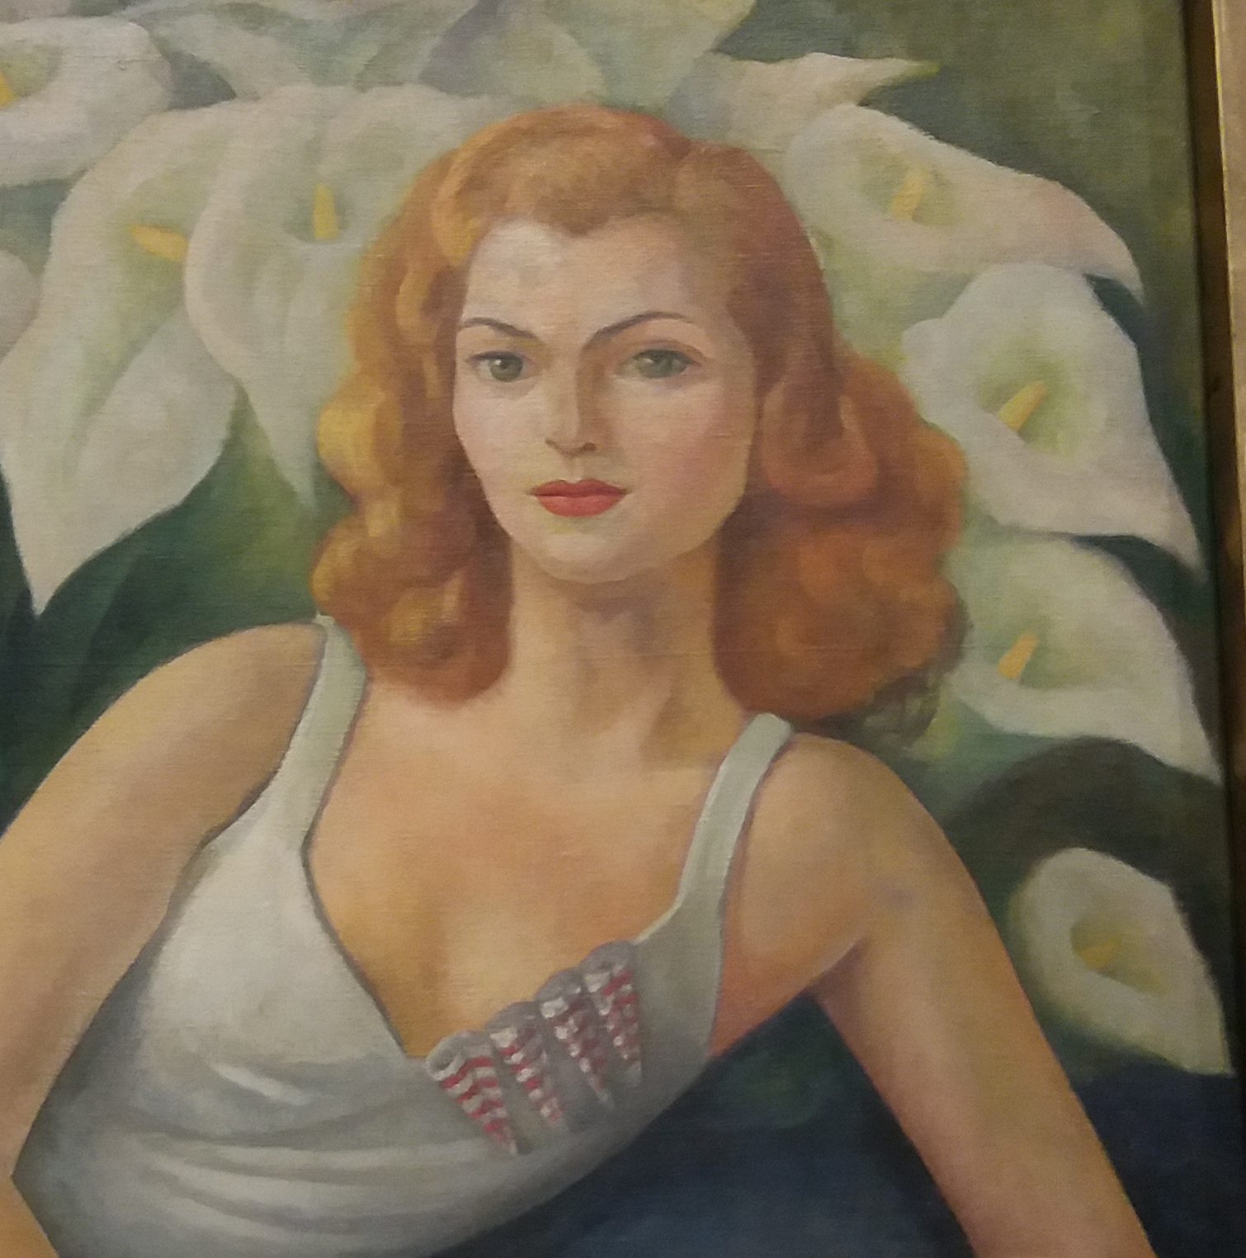
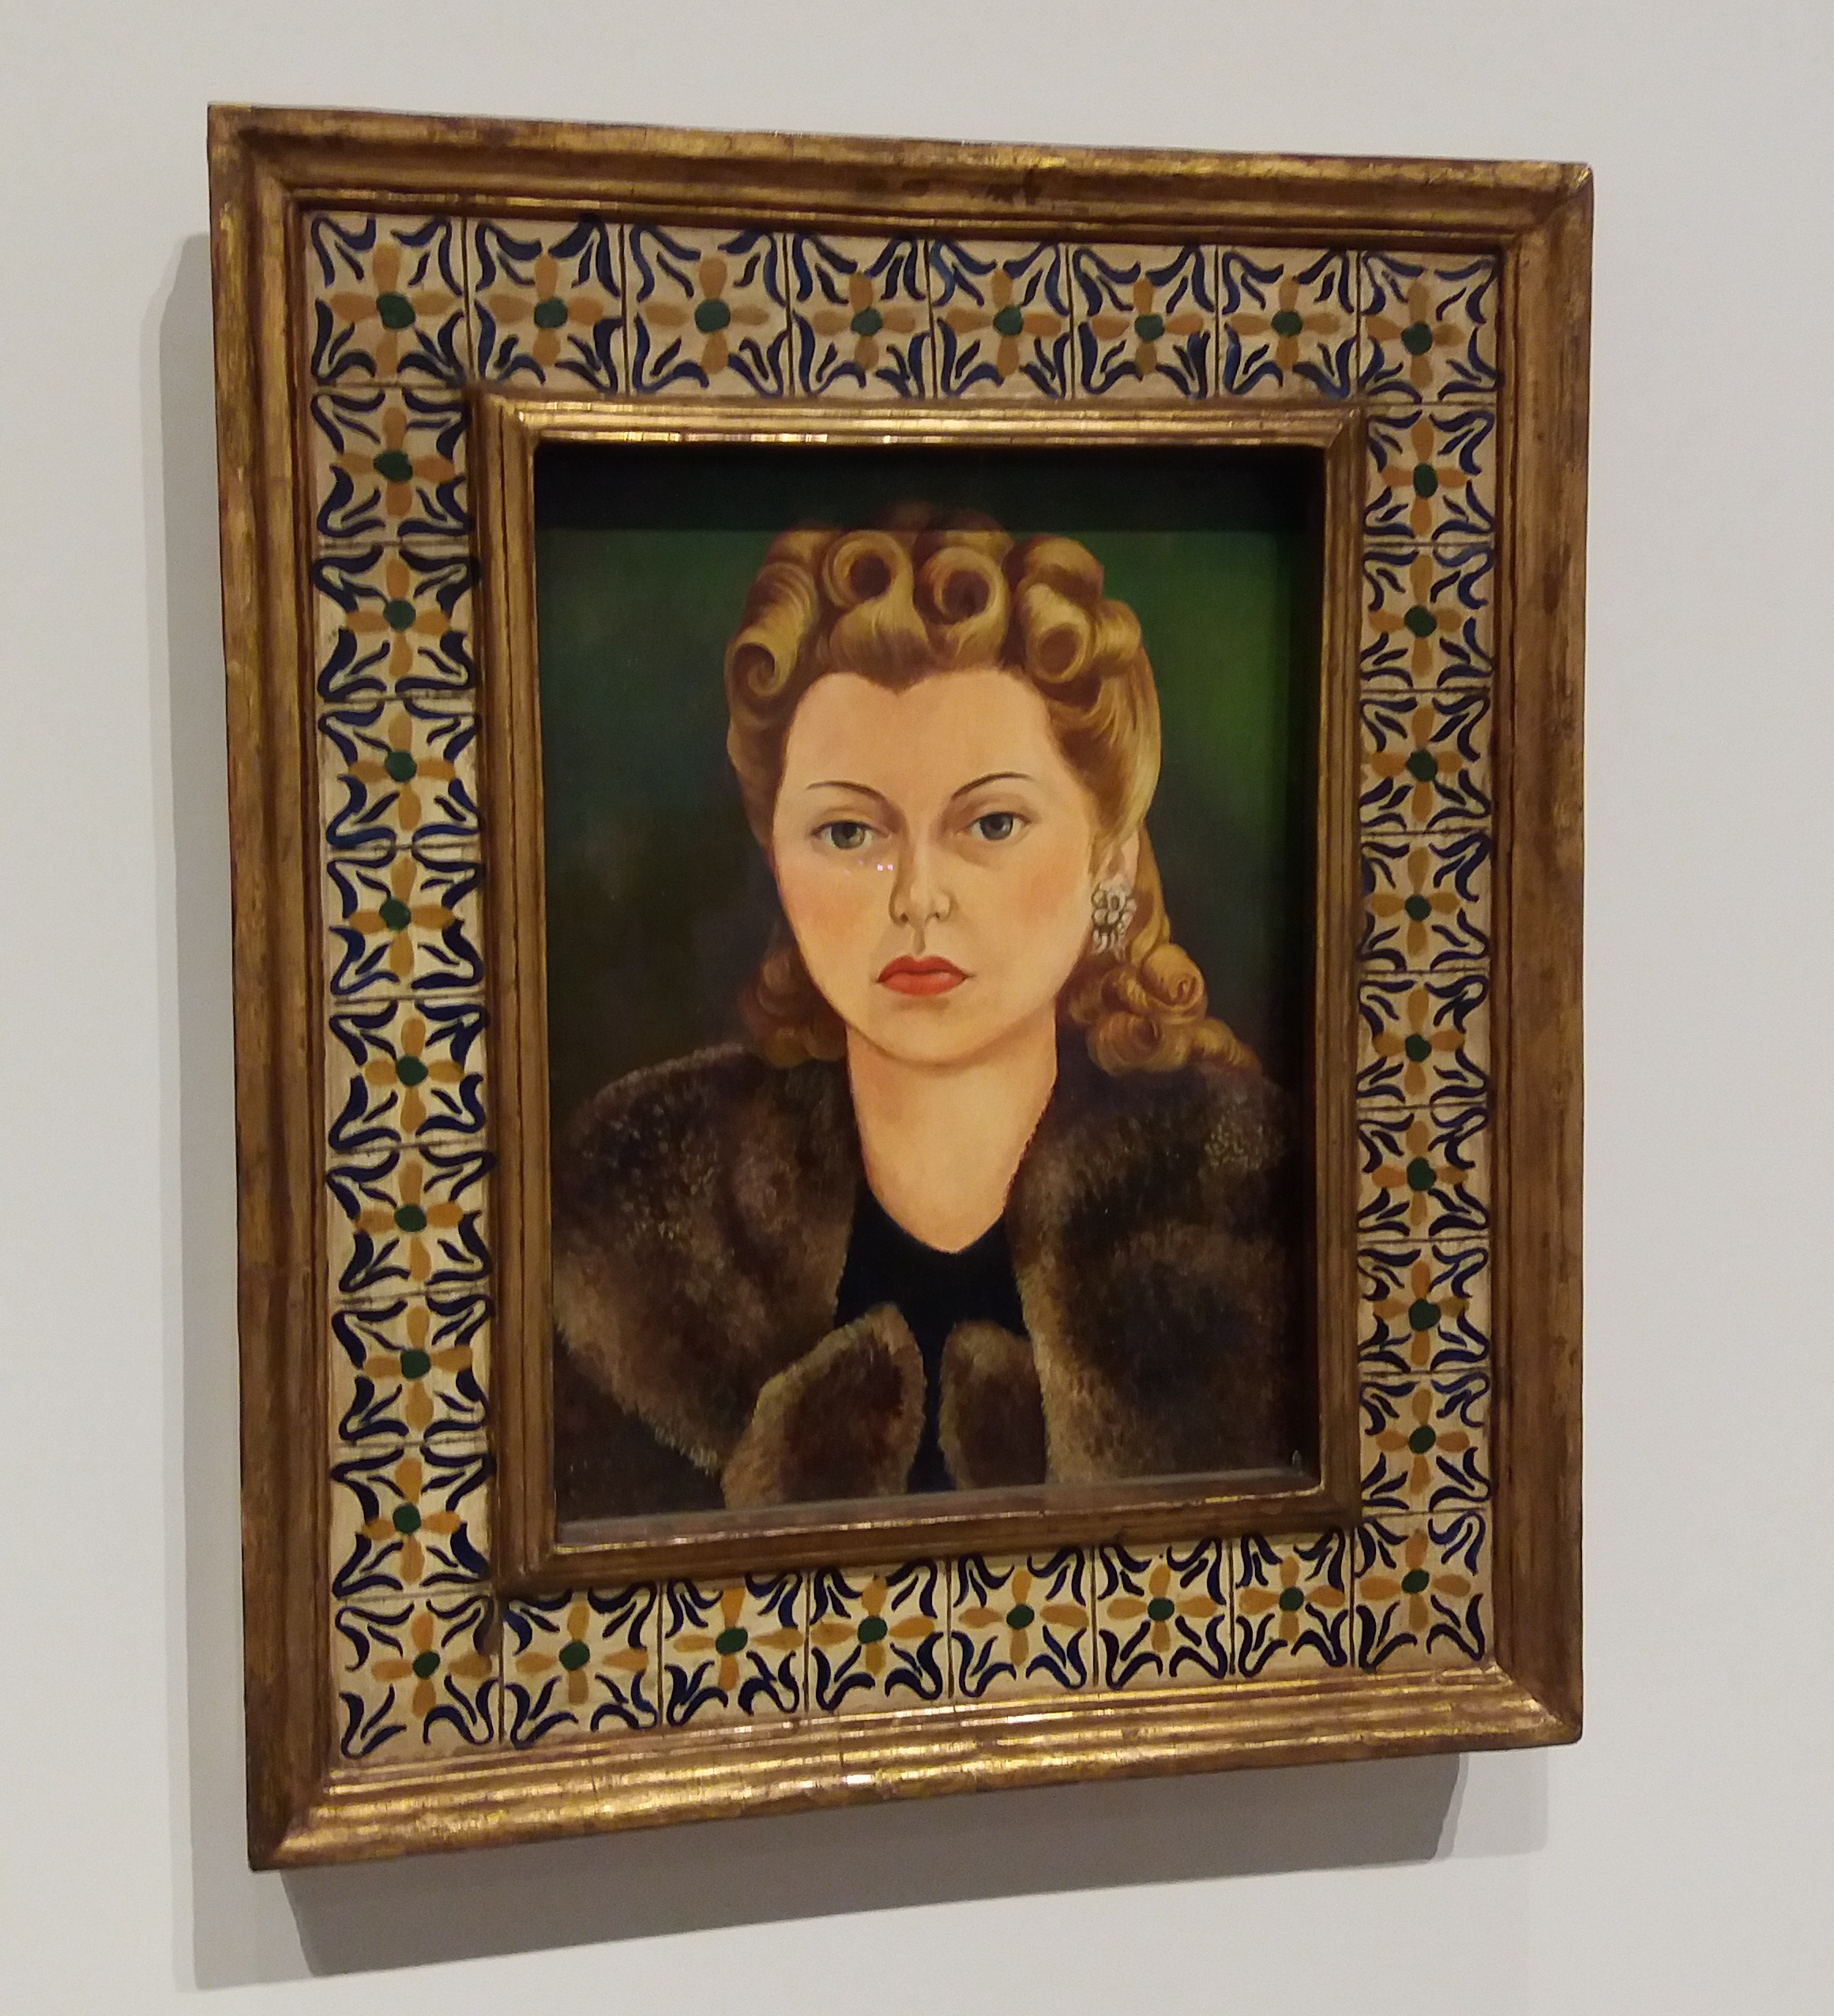

Slide 6
Back to the First Opening Question
How many truths are there?
Stephen Hawking (1996) wrote, “observers who are moving relative to each other will assign different times and positions to the same event. No particular observer’s measurements are any more correct than any other observer’s, but all the measurements are related” (p. 33).
“Truth is personal—it is what we see, assume, and believe, filtered through our own lens and orientation. Although it may revolve around the same subject or issue, the truth as one person perceives it may not be the same truth another person sees… There are many truths to a story and many versions of the same story” (Gutkind, 2012, p. 19).

Slide 7
One of my student’s answers:
“There’s one truth, it exists independently of us, and we may or may not be aware of it.”

Slide 8
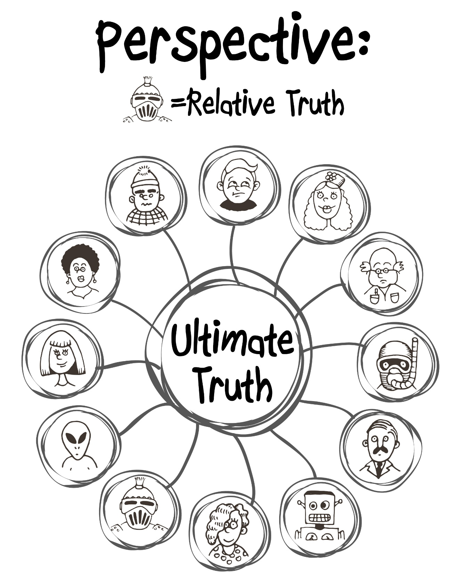

Slide 9

Lesson 1: Write your truth.
Your truth is unique because of your perspective.
You’re the only one who can know and tell your unique vantage point.
What about:
Validity?
  Just because it’s your personal truth doesn’t mean your argument is valid.
Rhetorical Purpose?
  Why and in what context are you sharing your personal truth?

Slide 10
Rewind: About Me
Taught 8th grade and 10th grade English in Carlisle, PA for 12 years
National Board Certified Teacher and a Fellow of the National Writing Project
Currently a TA and PhD Student (English Education) at Arizona State University
As a reader and a writer, I trend towards interesting, true stories (Creative Nonfiction)
My book: From Me to We: Using Narrative Nonfiction to Broaden Student Perspectives (Routledge)

Slide 11
Outline of Today’s Workshop
Presentation and conversation on the state of nonfiction in the literary landscape
  Building more authentic text sets
    How do we read, respond, and write in real life?
Reading activities for a narrative nonfiction text set
  Break time!
Writing activities for a narrative nonfiction unit

Slide 12
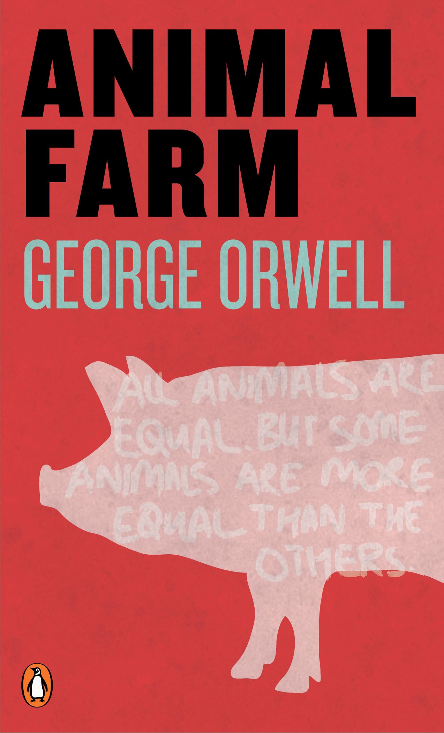
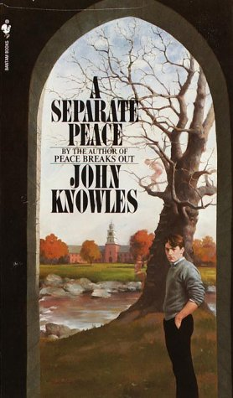
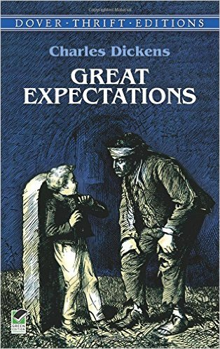
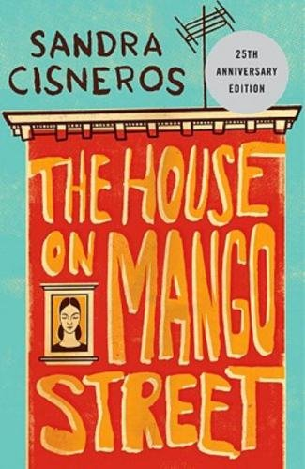
10th Grade Curricular Reading List

Slide 13


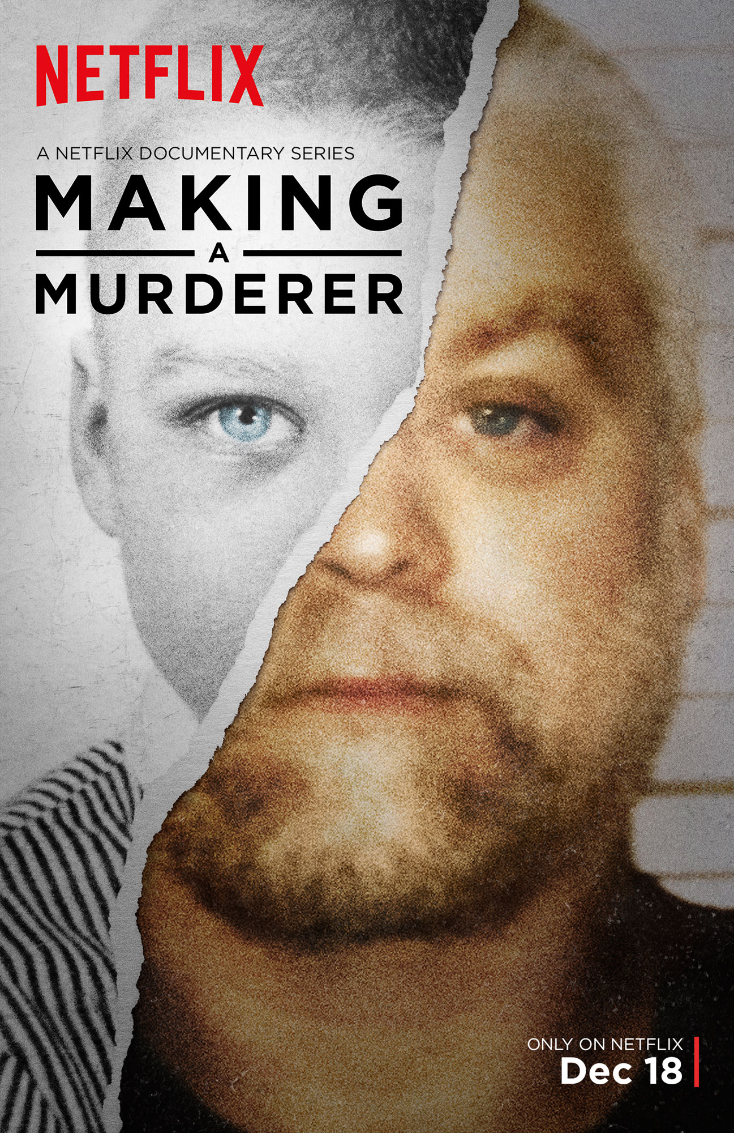


Slide 14
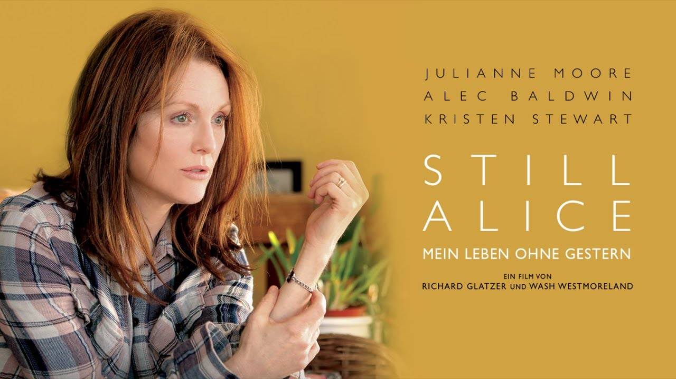
A Different Kind of Text Set
Lisa Genova- Can Alzheimer’s Disease Be Prevented?
  TED Radio Hour
Still Alice- Novel
  Still Alice- -Stage Play
    Still Alice- Feature Film

Slide 15


Slide 16
Narrative Disrespect
“The only problem with [personal writing] is as you grow up in this world you realize people don’t really give a shit about what you feel or what you think.” David Coleman in a Speech to the New York State Education Department
“You know, by the time they reach fifth grade, they pretty much know how to write a story.” My former director of C & I.
Penny Kittle labels these attitudes as “narrative disrespect” and writes, “[a]nyone who thinks [narrative] is easy hasn’t written a single story in a very long time. Perhaps ever.”

Slide 17
Common Core State Standards
By 11th/12th grade, students should be reading 70% informational text, 30% literary text
Is creative/narrative/literary nonfiction literary or informational?
“Narrative is a form or mode of discourse that can be used for multiple purposes—we use it to inform, to persuade, to entertain, to express. ‘It is the mother of all modes,’ a powerful and innate form of understanding” (Newkirk, 2014, p. 6).

Slide 18
Nonfiction Terminology
Creative Nonfiction: Literary Journals and MFA Programs
Literary Nonfiction: Common Core Standards
Narrative Nonfiction
CNF Magazine tagline: “True Stories, Well-Told”

Slide 19



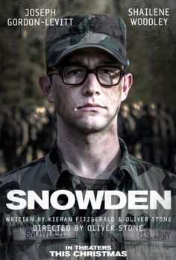

Slide 20
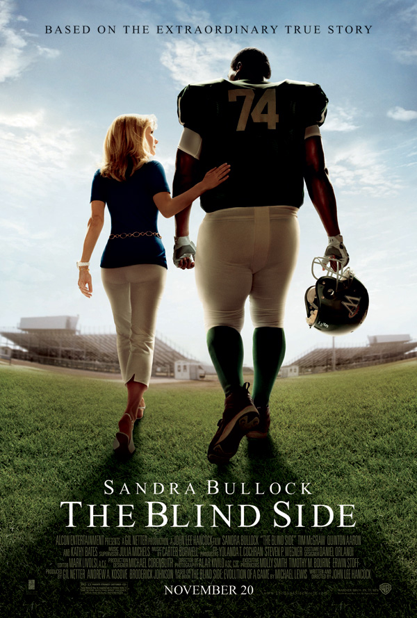

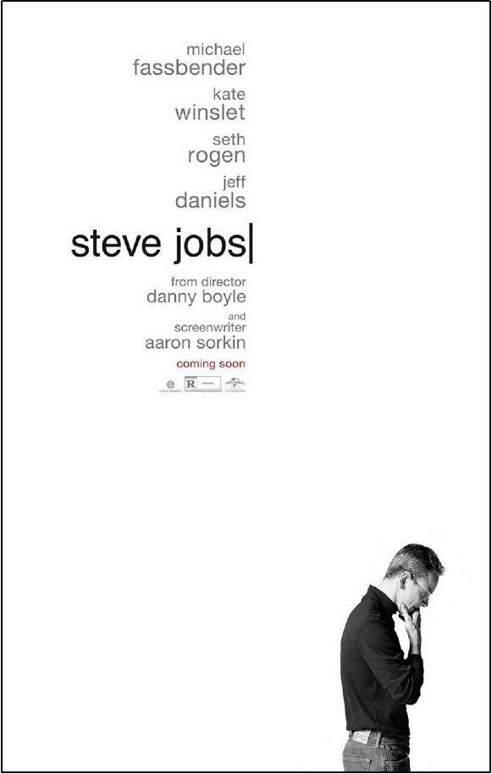
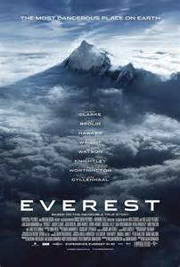

Slide 21
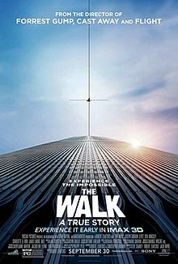
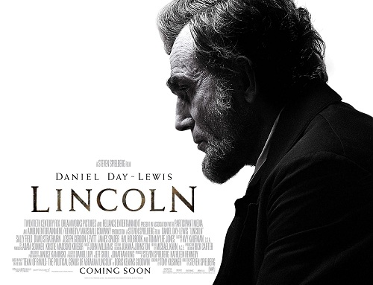



Slide 22


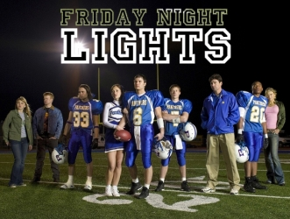


Slide 23
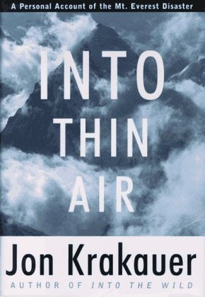
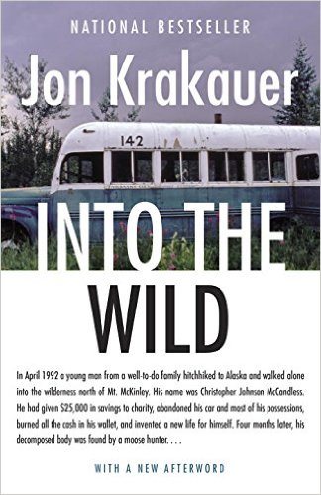
Krakauer

Slide 24
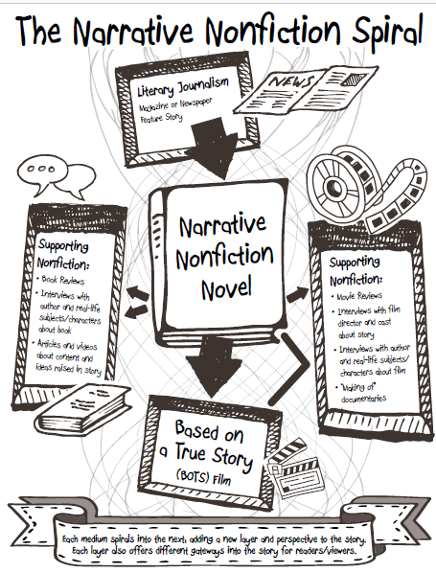

Slide 25
Reading Activities
Pre-Reading Inquiry Questions
1-1-1 Research Paper: 1 source, 1 quote, 1 page
Empathy Check-Ins
Ancillary Nonfiction
Watching the film as “rhetorical detectives”
  What was changed? Why? Was it effective?
Interact with authors, characters, subject-matter experts

Slide 26
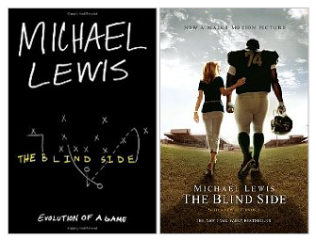
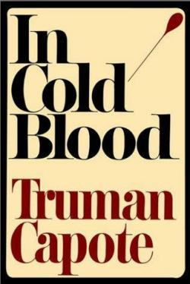

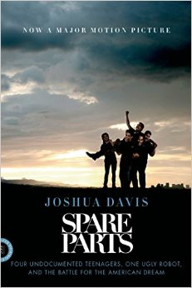

Notable Examples of the NNF Spiral

Slide 27
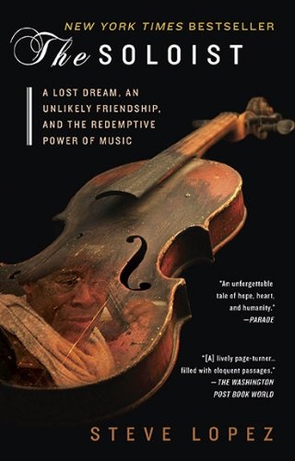

Slide 28
Reading Activity #1: Empathy Check-In
Take a few minutes to read “To (All) the Colleges That Rejected Me” by Suzy Lee Weiss
  Go to breathedeepandteach.com and open the PDF handout
  Google the title and PDF
  See me, and I’ll e-mail you the PDF
Answer the following:
  Do you like this narrator?
  Is the narrator fair?
  Regardless of whether you like the narrator, do you trust her?
Attach your answer(s) to specific textual evidence. For each, why or why not?

Slide 29
Reading Activity #2: Rhetorical Film Examination
Listen and/or read along (on the PDF) with the excerpt from Lopez’s The Soloist.
Make mental notes of memorable details (especially visuals).
Now, as we watch the corresponding film clip:
  What was accurate?
  What did the filmmakers change?
    Why did they make the changes they did?
  Rate the scene in terms of its effectiveness. How good of an adaptation was it?

Slide 30
What Students Said…
What can you get out of reading narrative nonfiction that you can’t get out of other genres like fiction or poetry?
  “Narrative nonfiction allows someone to experience real-life events that they would be otherwise ignorant of.” Duncan C.
  “Narrative Nonfiction is factually relevant and still exciting. Pure fiction isn’t true. Pure nonfiction is about as exciting as a textbook. Narrative nonfiction is a good balance of the two.” Sarah E.
  “You get a sense of real life problems in real time.” Tanna H.
  “Knowing that a story actually happened tends to bring the reader a little closer to what they are reading.” Sam B.
  “With narrative nonfiction, you see how the story can chance based on who’s telling it.” Emma L.
  “By reading the story of a real person with similar problems as you, you know you’re not alone and that other people go through the same things as you.” Tyler H.

Slide 31
What Students Said…
What’s one thing you learned from reading a narrative nonfiction book?
  “It is very easy to point out society’s faults, but it’s very difficult to correct them.” Sarah R.
  “I learned that, where mental illness is concerned, treatment does not occur in a straight line. In some cases, one step forward was equivalent to two steps backward.” Kara F.
  “Nonfiction can be more than a textbook or biography, but a story with an actual plot.” Bryce D.
  “Before reading the book, I knew that there was a homelessness problem, but I had no idea it was as big as described. I also didn’t know that homelessness was so closely related to mental illness.” Erik P.
  “It takes a lot of effort and patience to gain and keep a friendship with someone with a mental illness or disorder. It can be very frustrating but at the same time very rewarding.” Hannah M.

Slide 32
What better way to master literary elements than by writing with them?

Slide 33
Which is harder to write: fiction or nonfiction?
“The challenge faced by the nonfiction writer is to take something that actually happened, to herself or to others, and try to render it as honestly and compellingly as possible.” Phillip Lopate
“[T]he job of fiction is to find the truth inside the story’s web of lies.” Stephen King
GOOD STORIES ARE BOTH TRUE AND COMPELLING.
“But the truth we seek from novels is different from the truth we seek from memoirs . Novels, you might say, represent ‘a truth’ about life whereas memoirs and nonfiction accounts represent ‘the truth’ about specific things that have happened.” Daniel Mendelsohn

Slide 34
Millennials are Selfish, Right?
Biology (Coulter, 2001): Two major periods of brain growth around the ages of 15 and 22 in the frontal lobes.
Role of young people in society: figuring out what to do next.
Adults ask students, “What are you going to do next?”
“[M]ost teens since post-World War II America… eagerly embraced opportunities to break away from their parents and establish their own cultural milieus, independence, and identities.” S. Craig Watkins
What if we use self-centered nature as a tool for self and world discovery?
Contextualizing story: telling ours, listening to others, and bringing these into context with each other.

Slide 35
Lesson 1: Write your truth.
Your truth is unique because of your perspective.
You’re the only one who can know and tell your unique vantage point.

Slide 37
Writing Activity #1: Perspective Walk
Take your class for a 10 minute walk around campus, and then write the story of their walk.
Same relative time/place/experience
Why would the stories be different?

Slide 38
Writing Activity 2: Interesting People
In your notebooks, draw a T-chart
On the left, list five of the most interesting people you’ve ever met.
On the right, note the characteristics that make those people so interesting.

Slide 39
Lesson 2: Build the reservoir
Our best ideas for writing don’t come on demand.
Ray Lamontagne: fireflies
We need a method for idea collection
  Writer’s notebooks
  Apps (like Evernote)
We need to write regularly

Slide 40
Some of my favorite prompts
642 Things to Write About (826 Valencia)
Something you had that was stolen.
Tell the true story of a dramatic moment in your life, but weave in one secret and one lie.
Open your kitchen cabinet. Write a scene incorporating the first three things you see.
The road to hell is paved with good intentions.
A conversation that you weren’t supposed to overhear.

Slide 41
Listing
The stories you find yourself telling over and over.
The experiences that have had the biggest impact on your life.
Experiences that haunt you.
Your personal triumphs.
First times.
Favorites and least favorites.
Pet Peeves
Most embarrassing moments.
Best and worst things others have said to you.

Slide 42
Mine your social media
Look back over your posts, tweets, tags, photos, etc.
Which have a deeper story to tell?
Which would be interesting to an audience?

Slide 43
Writing Activity 3: Return to your list of interesting people
Choose one of your interesting people.
Write a brief and true scene which SHOWS one (or more) of their interesting characteristics.
Remember the elements of a scene: Start/End, Something happens, actions and dialogue, active voice.

Slide 44
Lesson 3: Put the reader in your shoes.
“Show, don’t tell.”
How?
Through scenes: “[f]irst, a scene must contain action. Something happens” (Gutkind, 2012, p. 114) and, “scenes have a start and a finish, a beginning and an end” ( Gutkind, 2012, p. 119).
Active vs. passive voice.

Slide 45
Lesson 4: Frame it Right
Make a good impression
First-lines activity.
  Stephen King: “[h]ow can a writer extend an appealing invitation -- one that's difficult, even, to refuse?”
A good unspoken last line: “And nothing was the same after that.”

Slide 46
Writing Activity #4: Ranking First-Lines
Listen to the first lines of the following stories and give them a ranking of 1 (least interesting) to 5 (most interesting)
After hearing the entire opening paragraph, give a thumbs up if your interest goes up or a thumbs down if your interest goes down.
Advice (from memoirist Jane Bernstein) for closing lines… if you can put an unwritten/unspoken, “And nothing was the same after that,” you’re done.

Slide 47
Topics Selected
Being homeless, learning about the death of a grandparent from suicide, having an abortion and being kicked out of the house, marching in an anti-abortion rally, finding a pet frozen after a snowstorm, revealing a same-sex crush, watching a sibling’s emerging clinical depression, learning that an uncle just committed murder, a chainsaw accident while logging, hiding from a blind man in a restroom…
If we ask them to, and they trust us, students will write honestly.
Responsible empowerment: Timing, peer-review, censorship

Slide 48
What Students Said…
What did you learn about yourself by writing a personal essay?
  “I leaned that you should be willing to fight for who you are, and that a true sense of self requires constant questioning and change, especially for a teenager.” Alex P.
  I learned that I have been independent. Much more than I realized.” Violet B.
  “I don’t value family enough, I trust too easily, and sometimes kids are stronger than adults.” Abby R.
  “I learned that circumstances I go through affect and teach the people who love and care about me.” Grace W.

Slide 49
What Students Said…
What did you learn about others and/or the world by writing a personal essay?
  “People aren’t always who they say they are, but even a person everyone perceives as negative can change your life for the better.” Rowan Y.
  “People don’t usually hurt you unless they are hurt themselves.” Ellen D.
  “Environment has more of an impact on some people versus others. Note everyone is limited or unlimited by where they come from.” Ian P.
  “The world is full of adventure and amazing experiences waiting to happen—you just have to be willing to explore and take some hikes.” Kristen L.

Slide 50


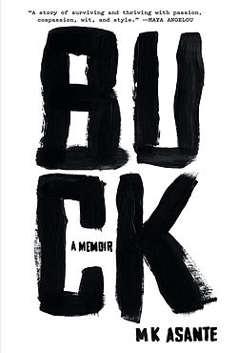
Interviews with Nonfiction Writers
Professional Writer: MK Asante
Student Writer: Jo Bear

Slide 51
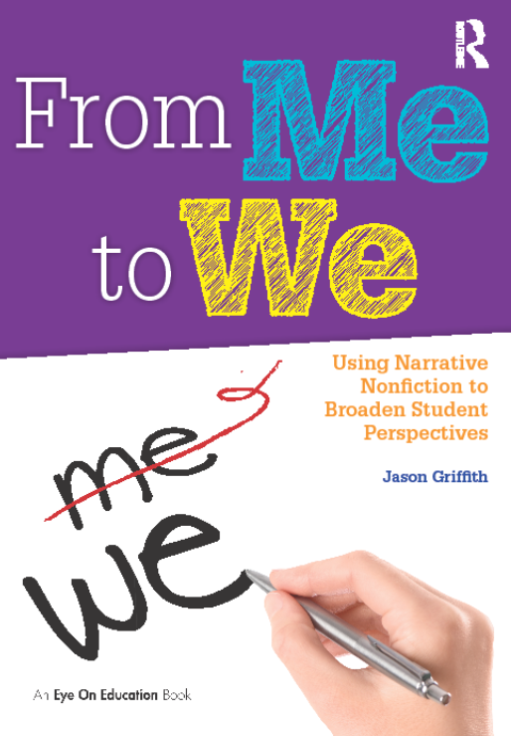
Handouts and PPT at
The Level Up Google Link and
Breathedeepandteach.com
Last page includes a code for 20% off my book at Routledge’s website.
Thanks for coming!!! Please take a moment to rate the session via the online survey with the 4-digit code.

