Slide 1
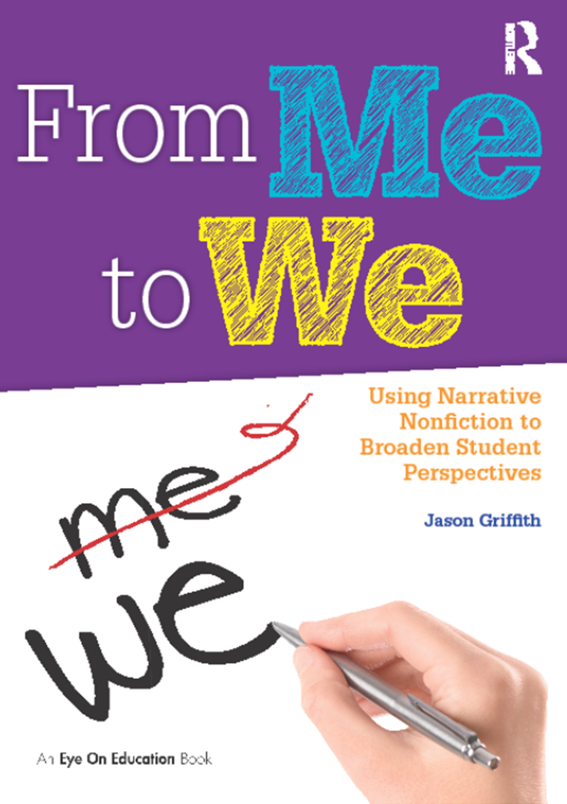
Jason Griffith
Arizona State University
@JGriff_Teach
#pctela17

Slide 2
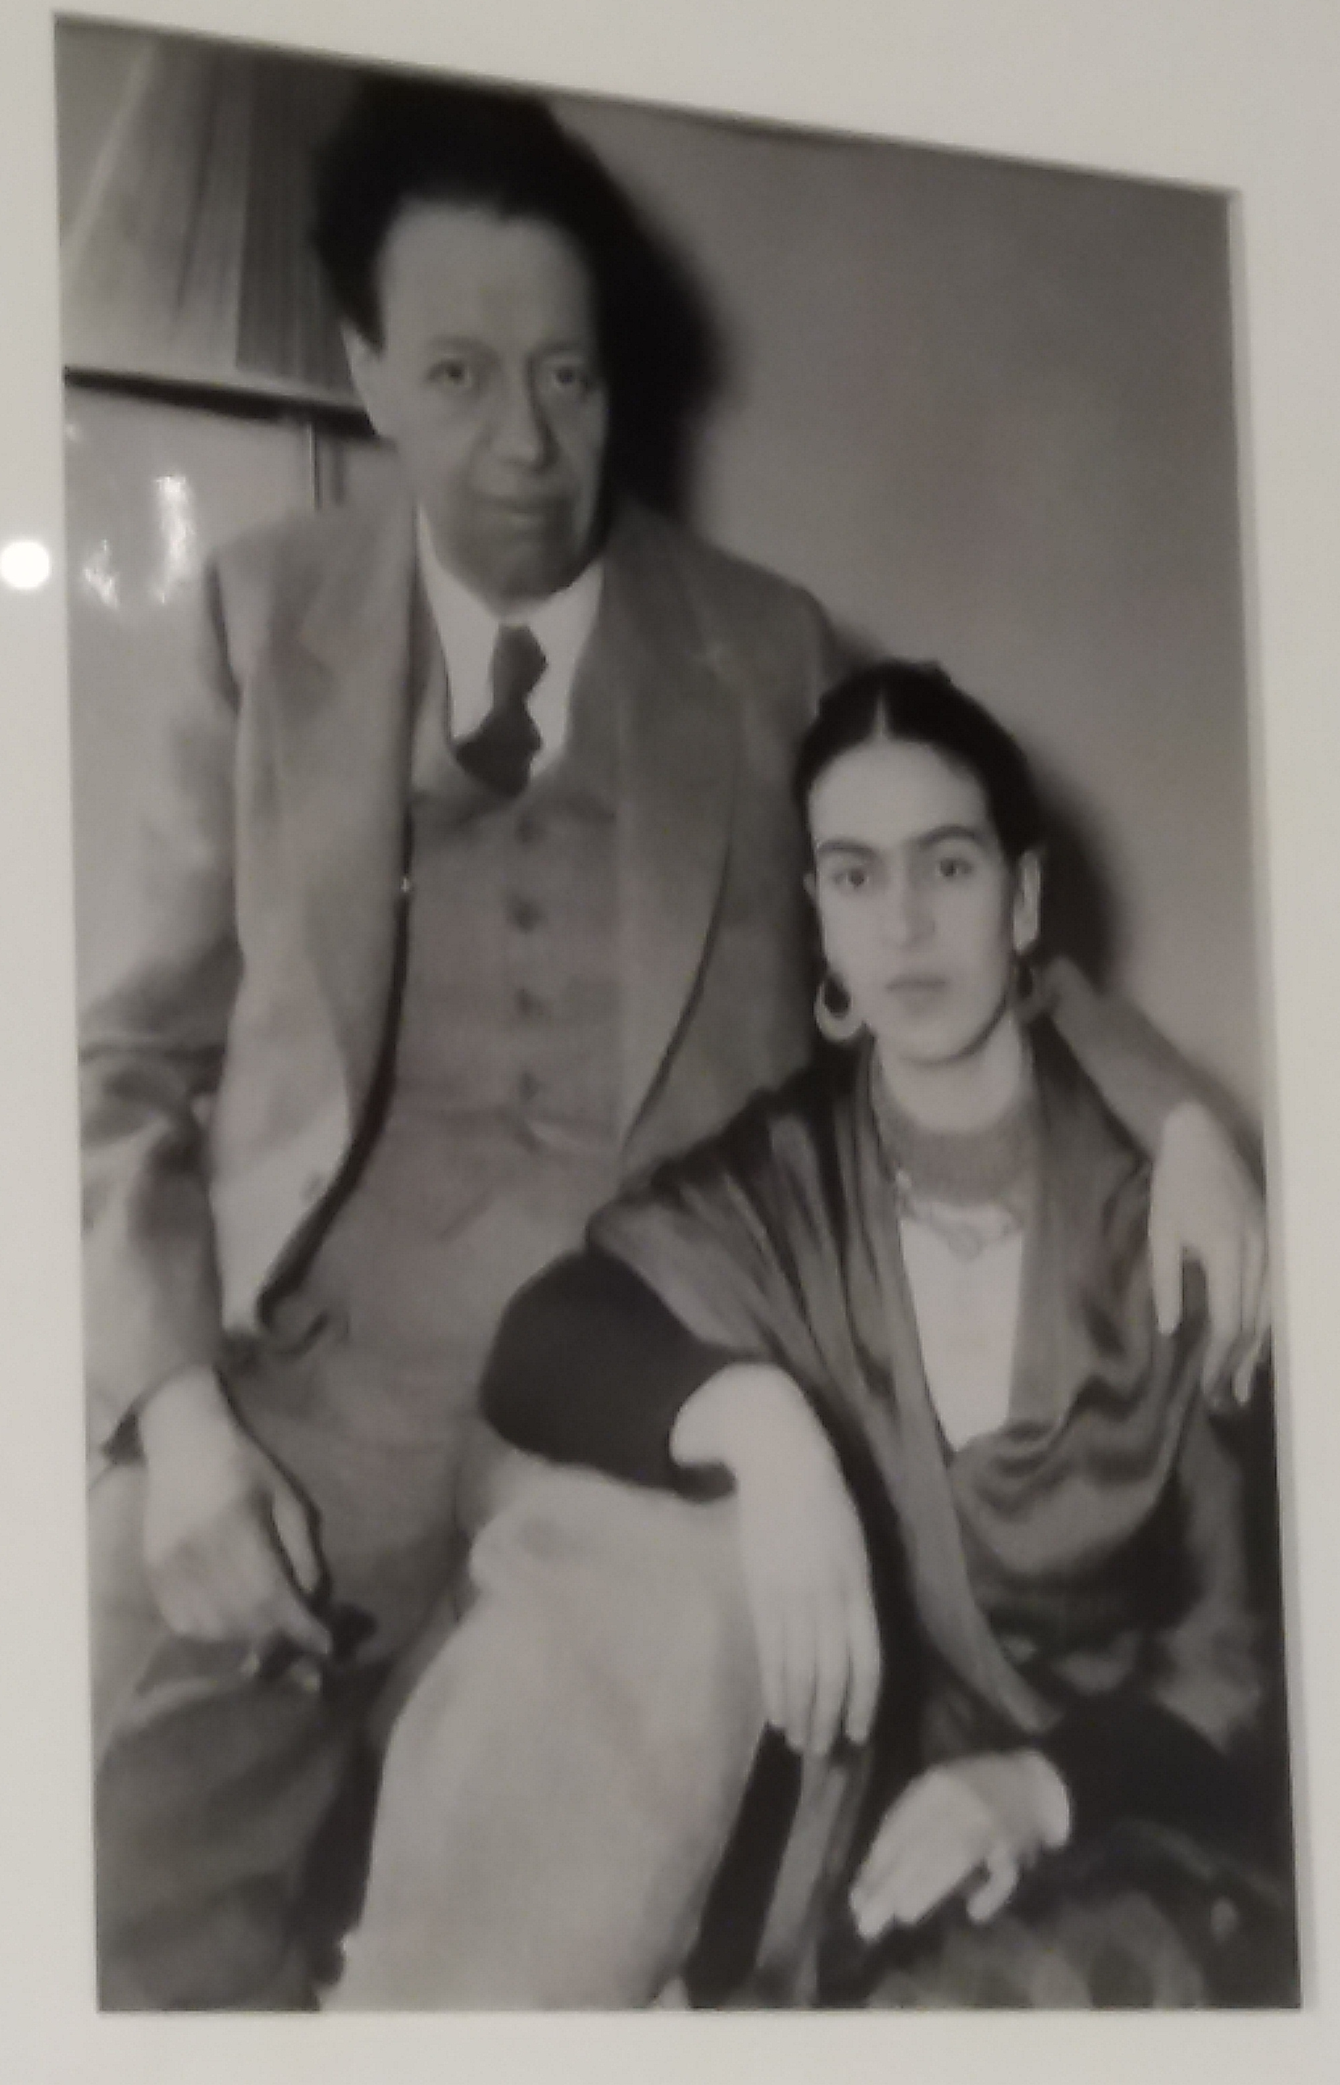
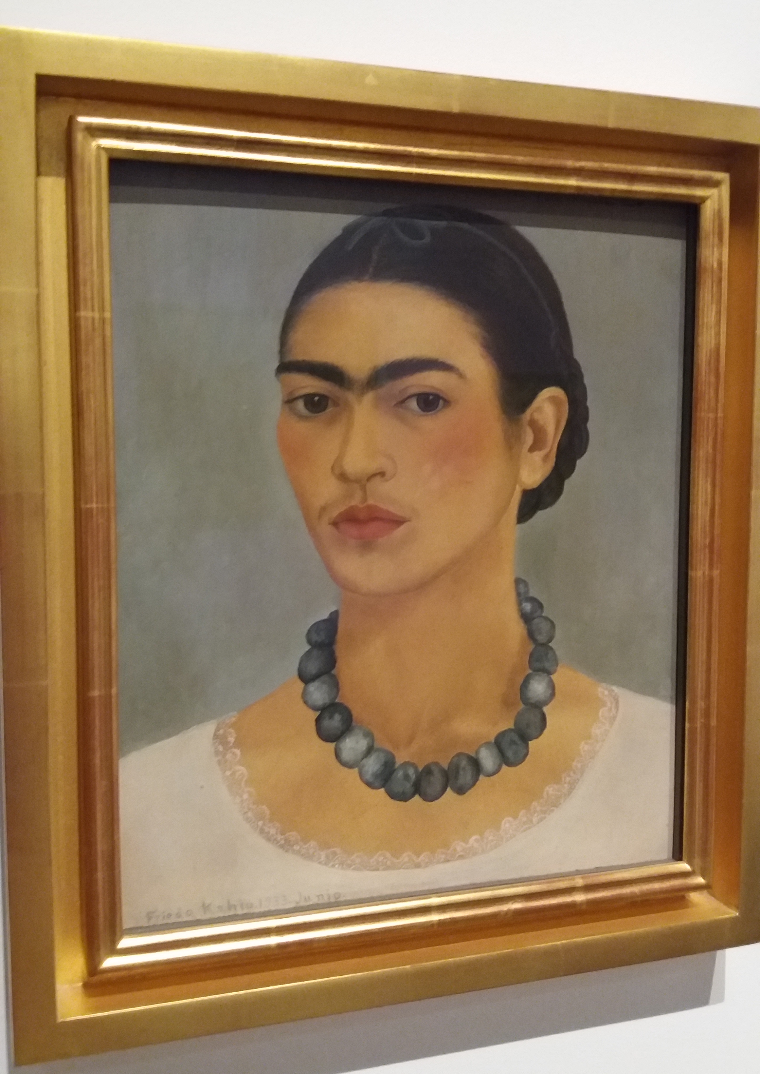

Slide 3
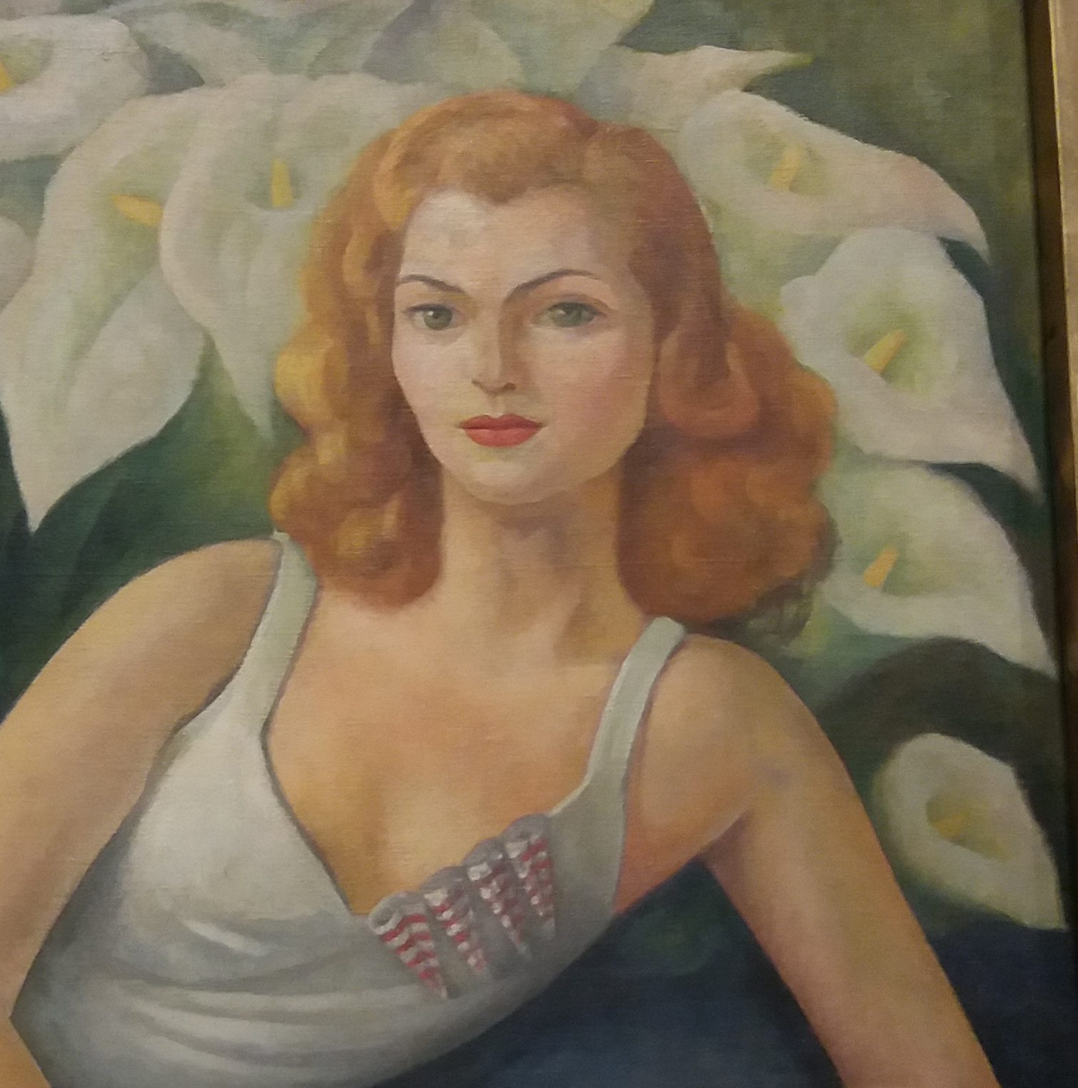
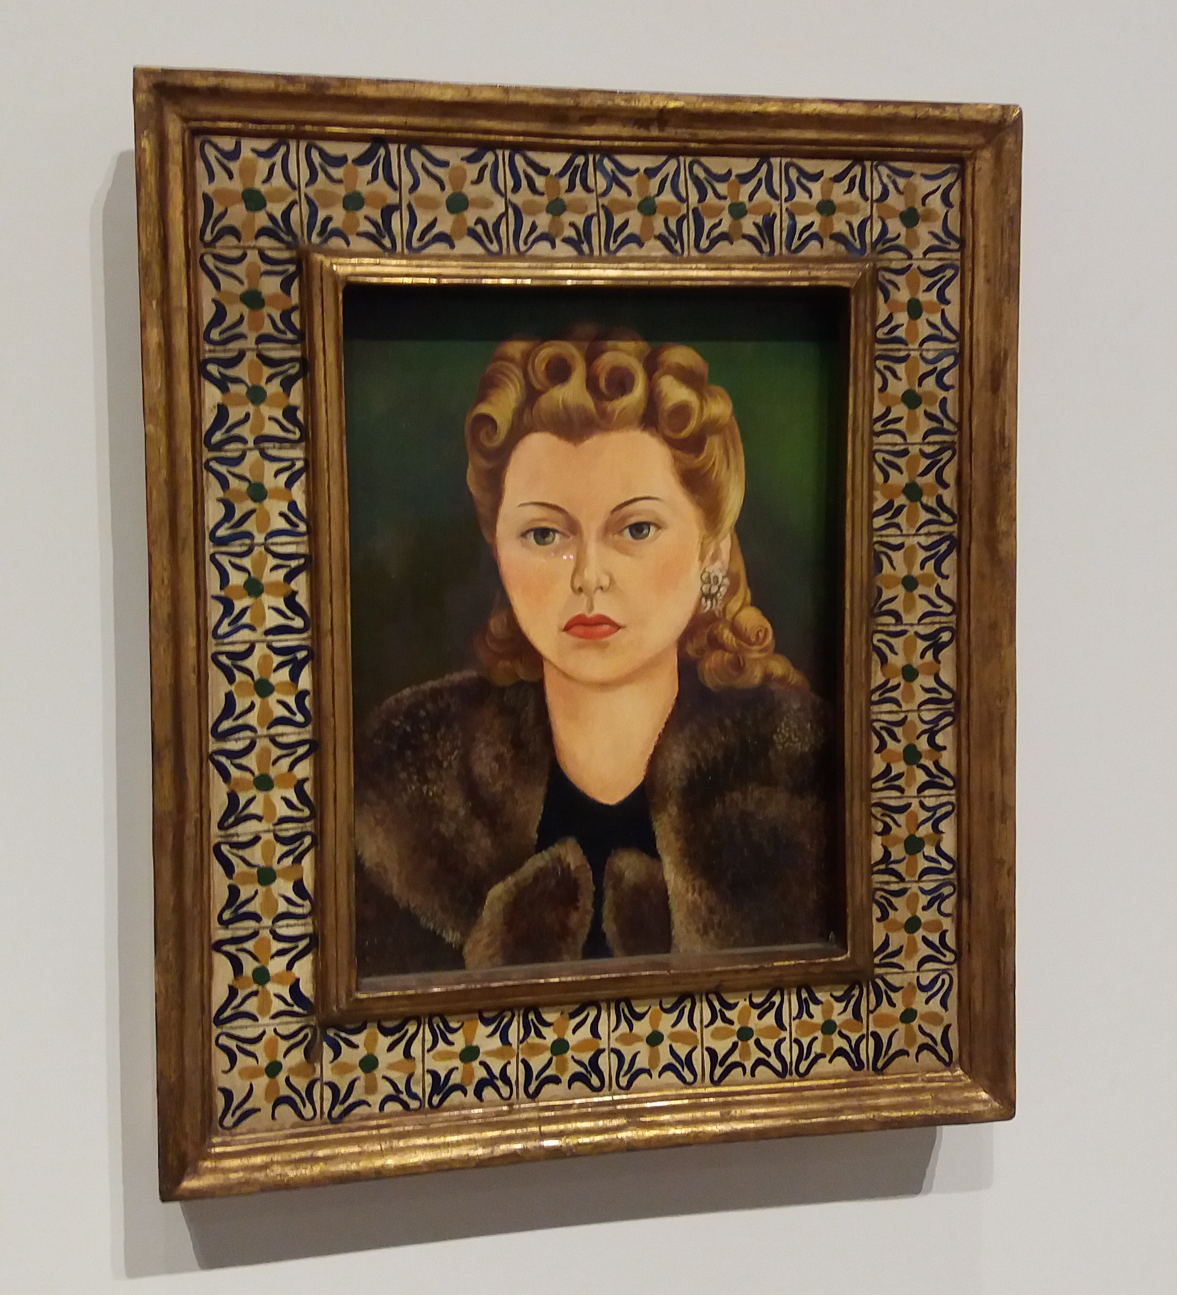

Slide 4
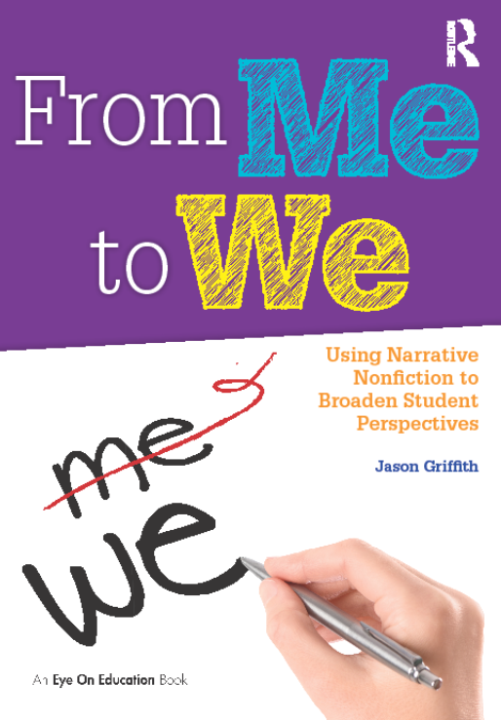

Slide 5
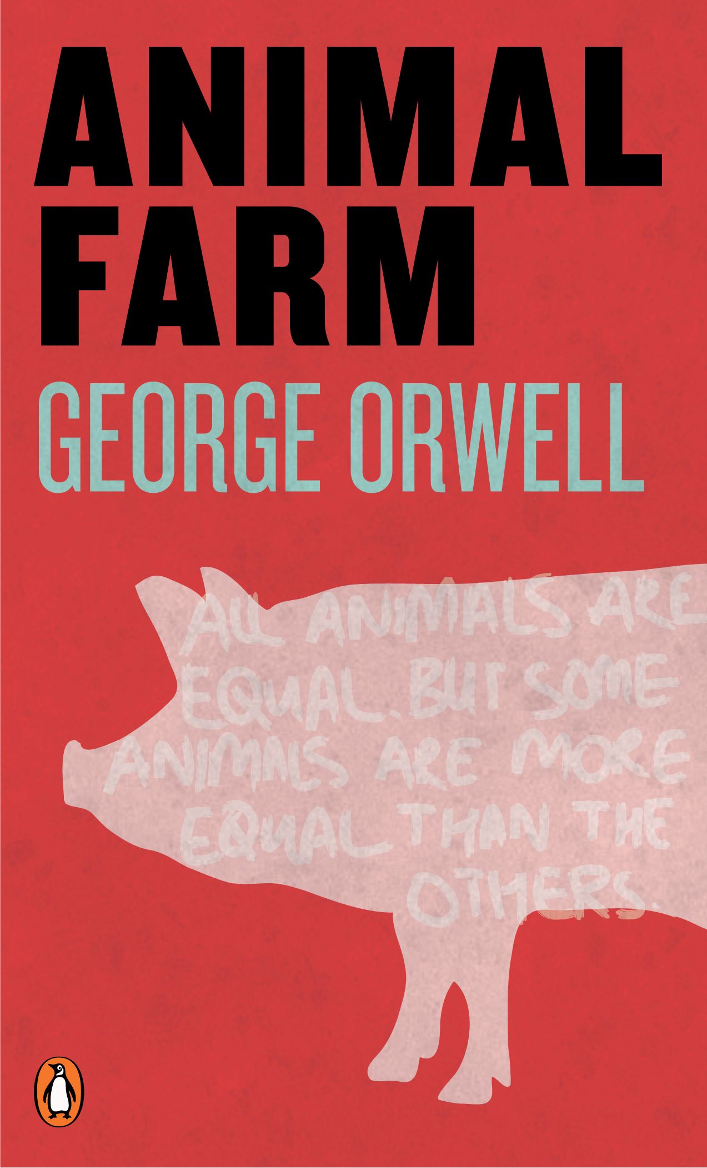
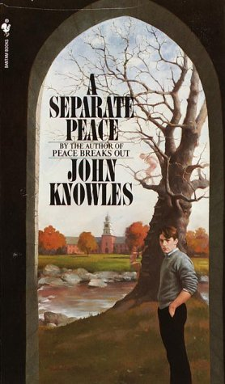
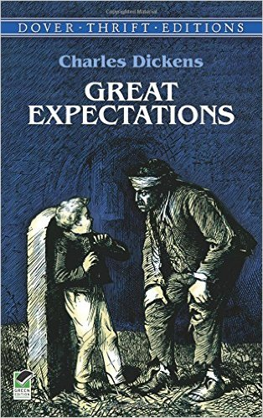
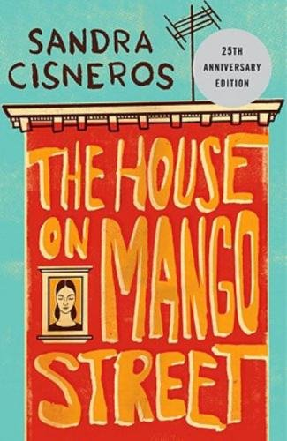
10th Grade Curricular Reading List

Slide 6


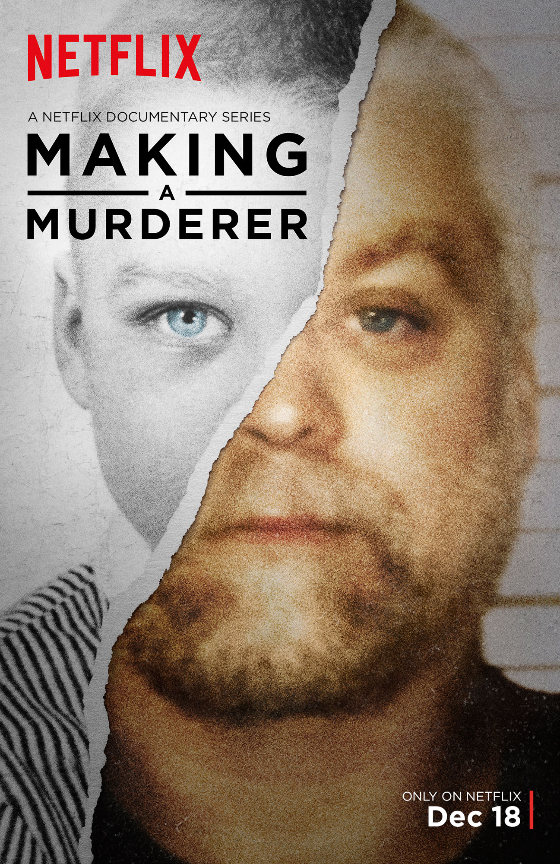


Slide 7
Common Core State Standards
By 11th/12th grade, students should be reading 70% informational text, 30% literary text
Is creative/narrative/literary nonfiction literary or informational?
“Narrative is a form or mode of discourse that can be used for multiple purposes—we use it to inform, to persuade, to entertain, to express. ‘It is the mother of all modes,’ a powerful and innate form of understanding” (Newkirk, 2014, p. 6).

Slide 8
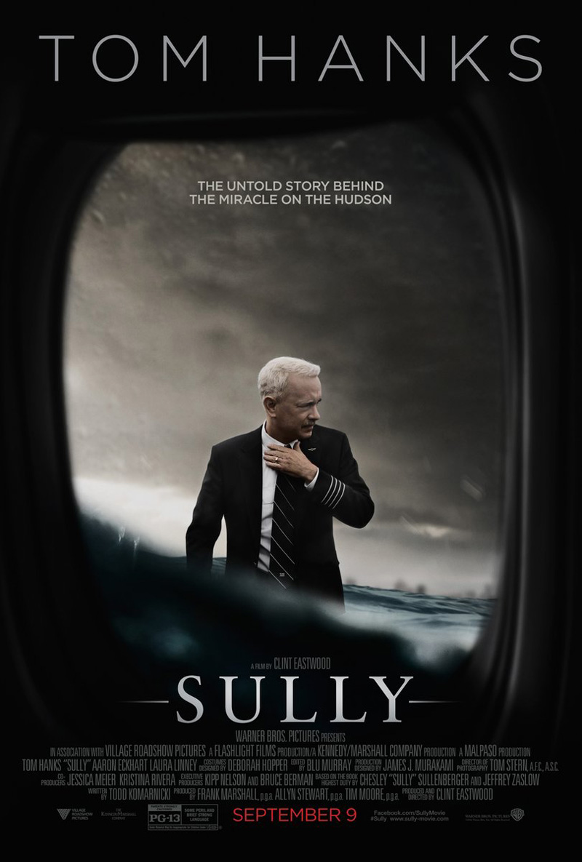
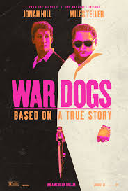
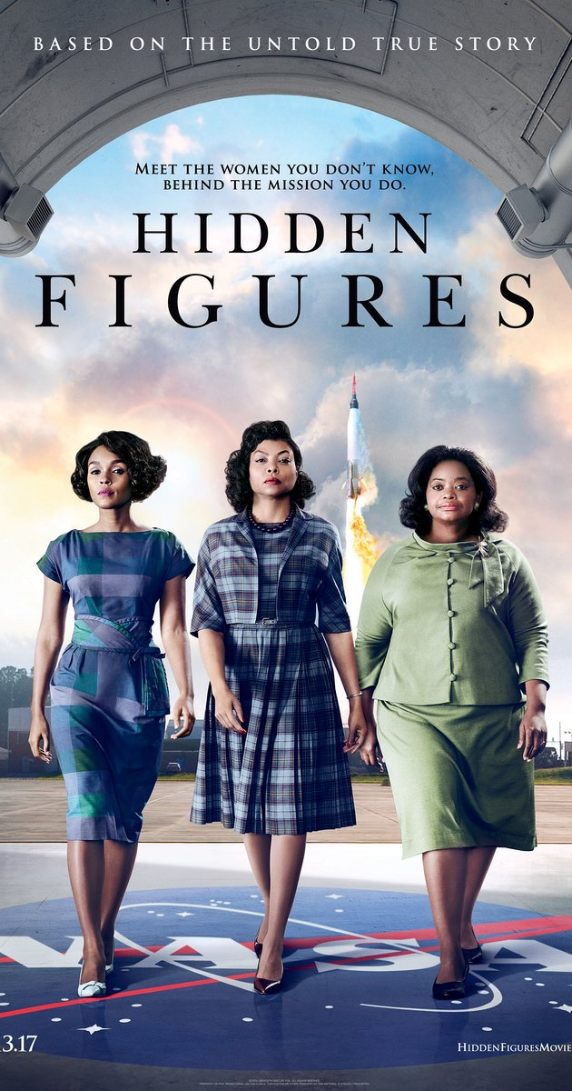
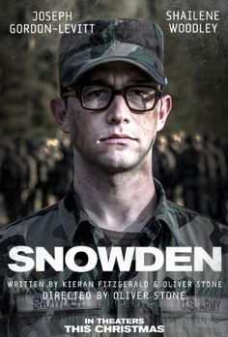

Slide 9
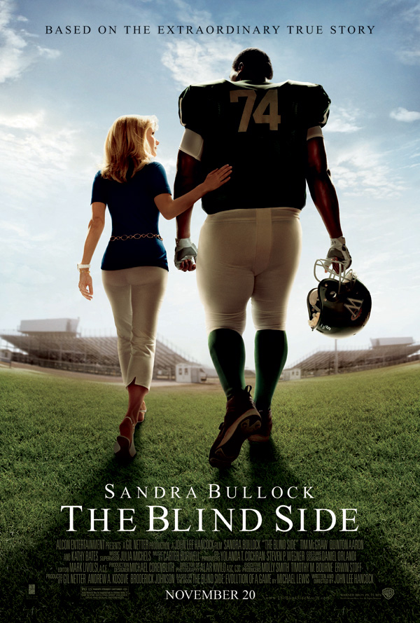

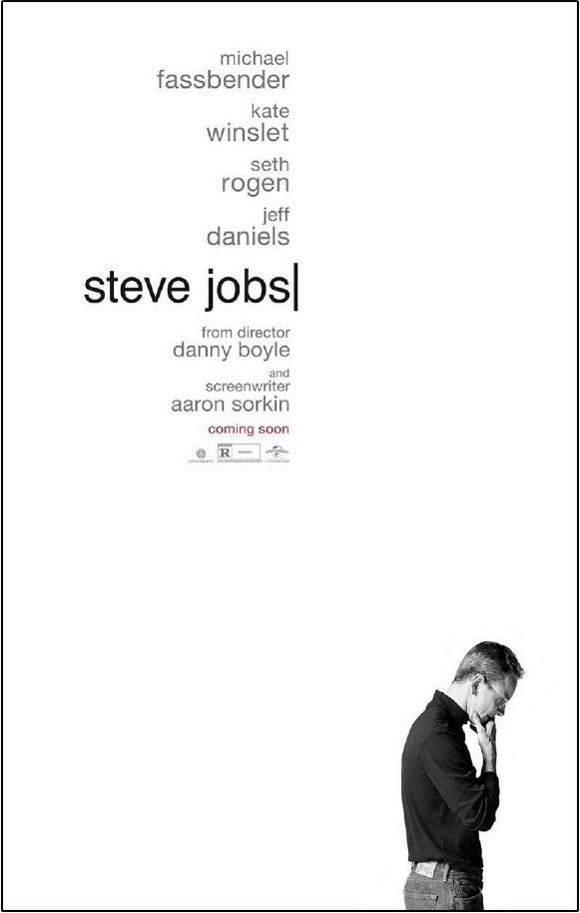
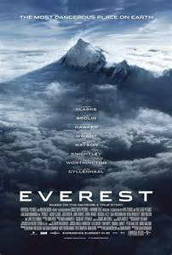

Slide 10
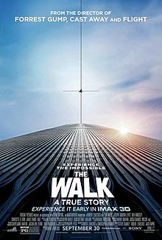
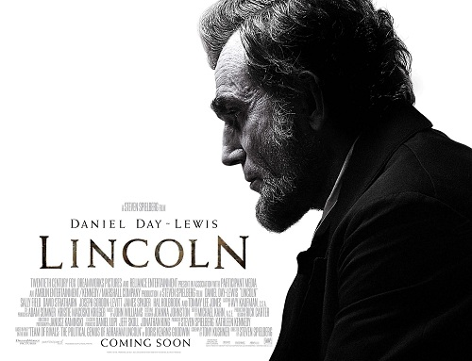

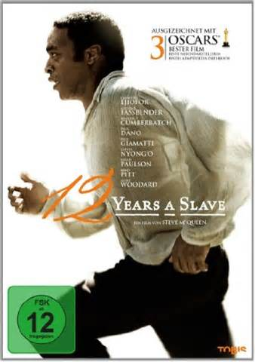

Slide 11

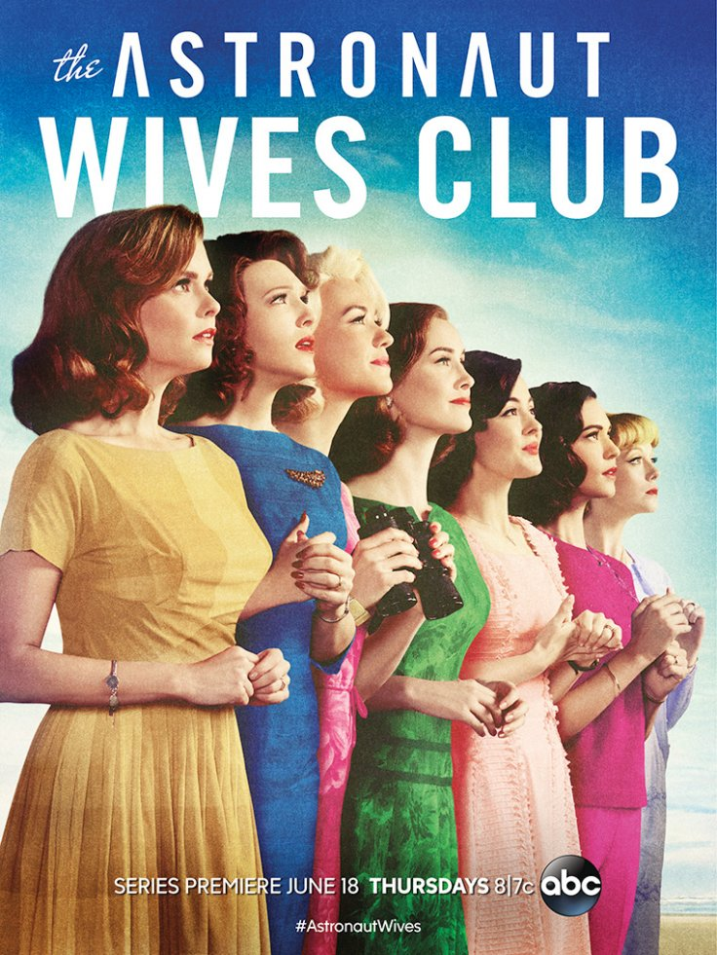
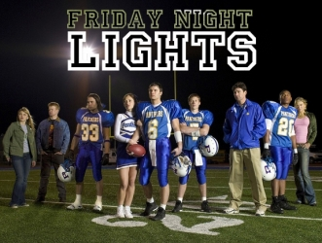


Slide 12
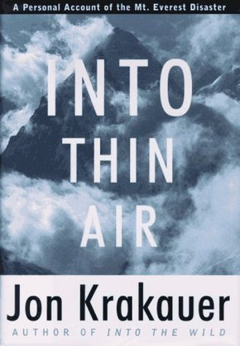
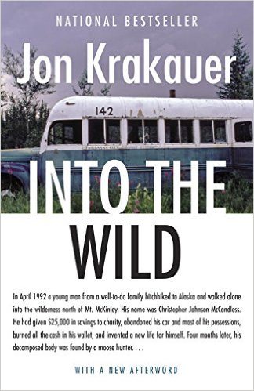
Krakauer

Slide 13
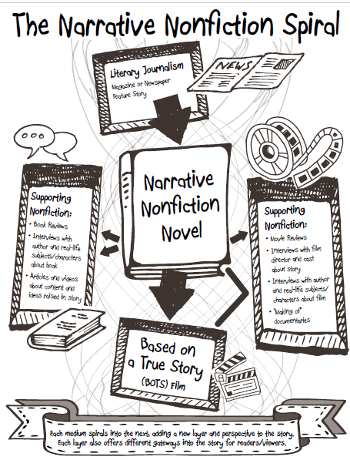

Slide 14
Reading Activities
Pre-Reading Inquiry Questions
1-1-1 Research Paper: 1 source, 1 quote, 1 page
Empathy Check-Ins
Ancillary Nonfiction
Watching the film as “rhetorical detectives”
  What was changed? Why? Was it effective?
Interact with authors, characters, subject-matter experts

Slide 15
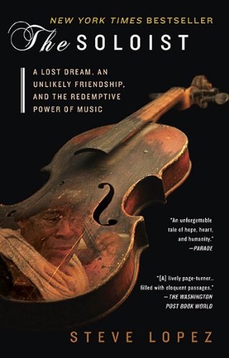

Slide 16
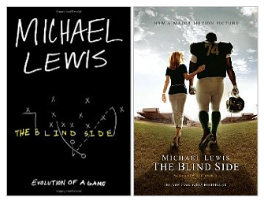
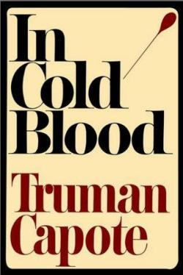
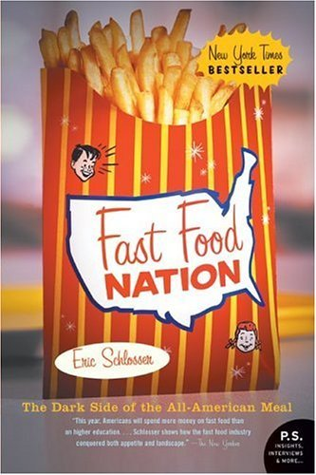
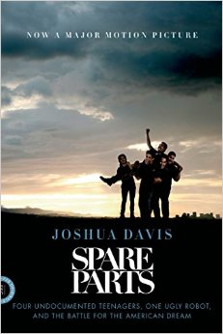

Notable Examples of the NNF Spiral

Slide 17
What Students Said…
What can you get out of reading narrative nonfiction that you can’t get out of other genres like fiction or poetry?
  “Narrative nonfiction allows someone to experience real-life events that they would be otherwise ignorant of.” Duncan C.
  “Narrative Nonfiction is factually relevant and still exciting. Pure fiction isn’t true. Pure nonfiction is about as exciting as a textbook. Narrative nonfiction is a good balance of the two.” Sarah E.
  “You get a sense of real life problems in real time.” Tanna H.
  “Knowing that a story actually happened tends to bring the reader a little closer to what they are reading.” Sam B.
  “With narrative nonfiction, you see how the story can chance based on who’s telling it.” Emma L.
  “By reading the story of a real person with similar problems as you, you know you’re not alone and that other people go through the same things as you.” Tyler H.

Slide 18
What better way to master literary elements than by writing with them?

Slide 19
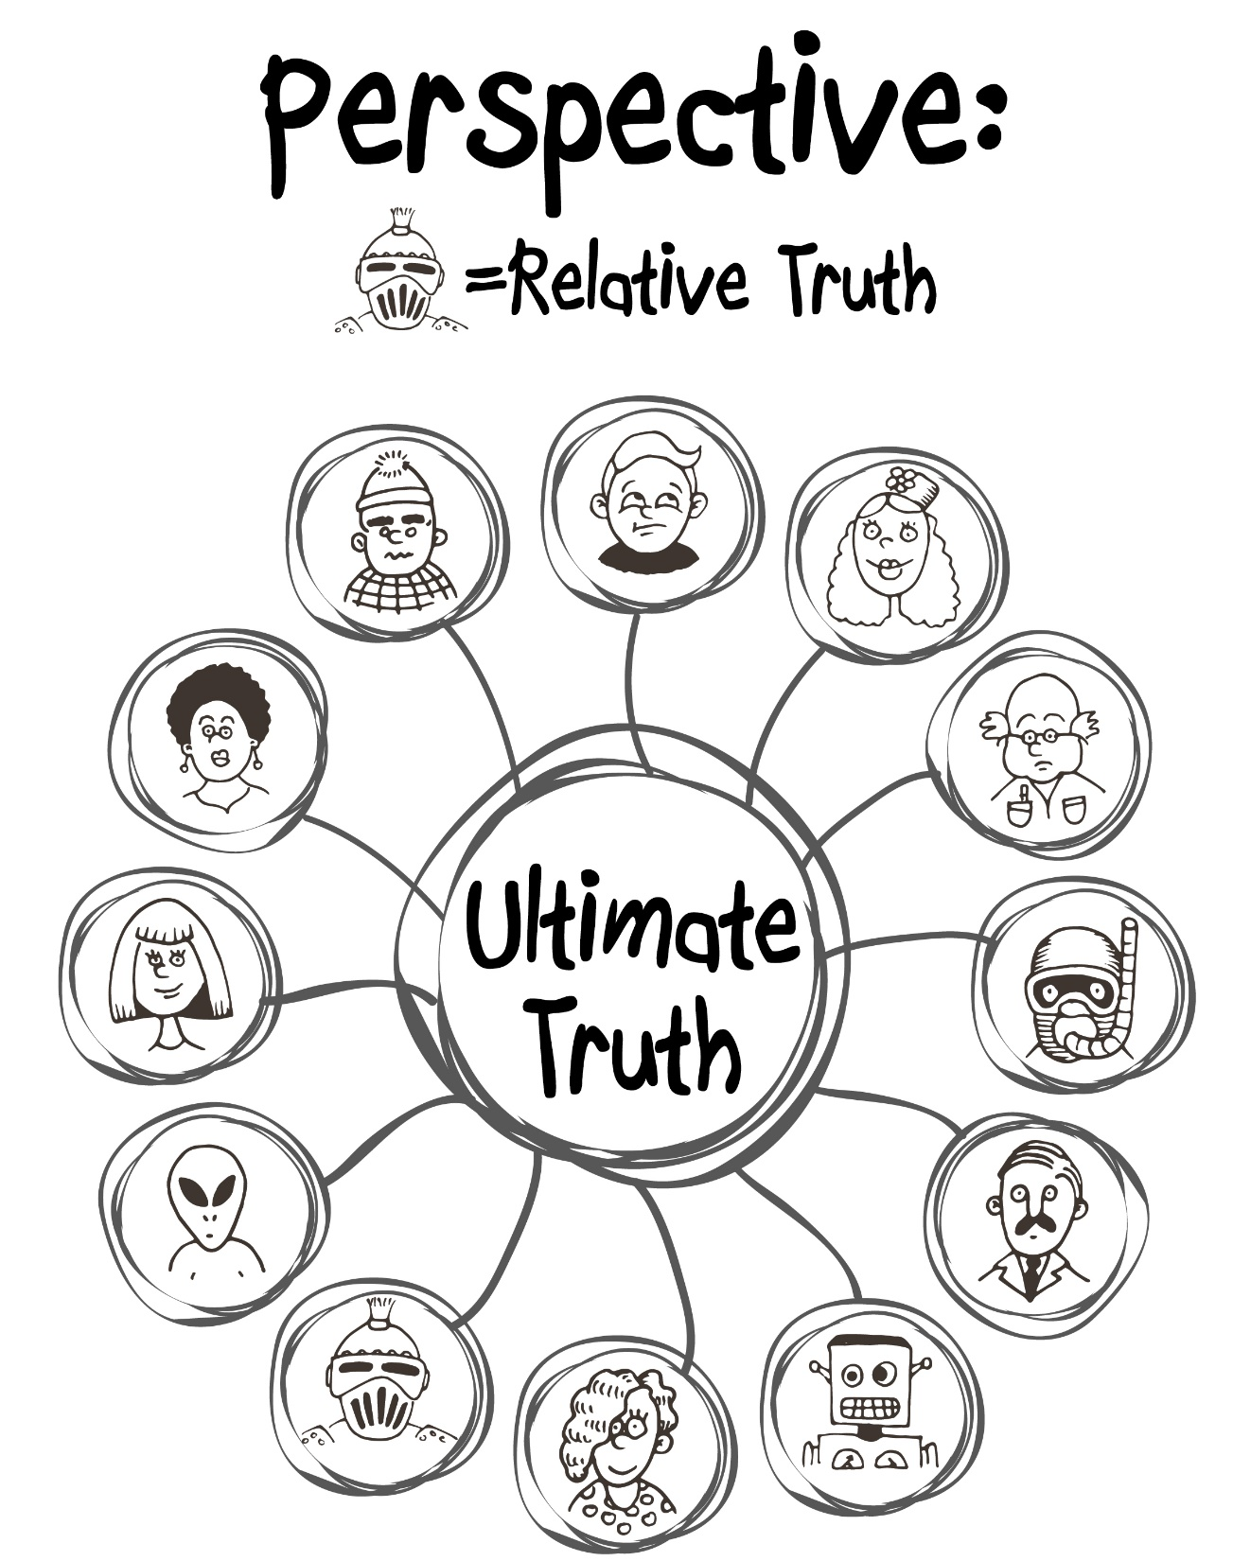

Slide 20
Activities for Writing Personal Essays
Perspective Walk: Take a walk, write “the story of our walk,” and compare accounts to examine relative truths.
Build the reservoir: Listing, Writing to Prompts, Freewriting, Mining Social Media, Keeping a Writer’s Notebook, Apps (like Evernote)
Create Scenes: Beginning and end (like a movie scene); action and dialogue
Beginnings and Ends: First-lines workshop- Rank and discuss published essay beginnings (mentor texts)

Slide 21
Topics Selected
Being homeless, learning about the death of a grandparent from suicide, having an abortion and being kicked out of the house, marching in an anti-abortion rally, finding a pet frozen after a snowstorm, revealing a same-sex crush, watching a sibling’s emerging clinical depression, learning that an uncle just committed murder, a chainsaw accident while logging, hiding from a blind man in a restroom…
If we ask them to, and they trust us, students will write bravely.
Responsible empowerment: Timing, peer-review, censorship

Slide 22
What Students Said…
What did you learn about others and/or the world by writing a personal essay?
  “People aren’t always who they say they are, but even a person everyone perceives as negative can change your life for the better.” Rowan Y.
  “People don’t usually hurt you unless they are hurt themselves.” Ellen D.
  “Environment has more of an impact on some people versus others. Note everyone is limited or unlimited by where they come from.” Ian P.
  “The world is full of adventure and amazing experiences waiting to happen—you just have to be willing to explore and take some hikes.” Kristen L.

Slide 23


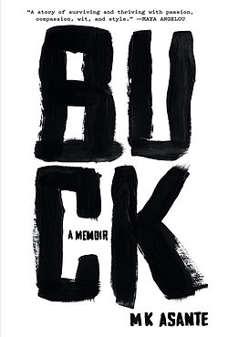
Interviews with Nonfiction Writers
Professional Writer: MK Asante
Student Writer: Jo Bear

Slide 24
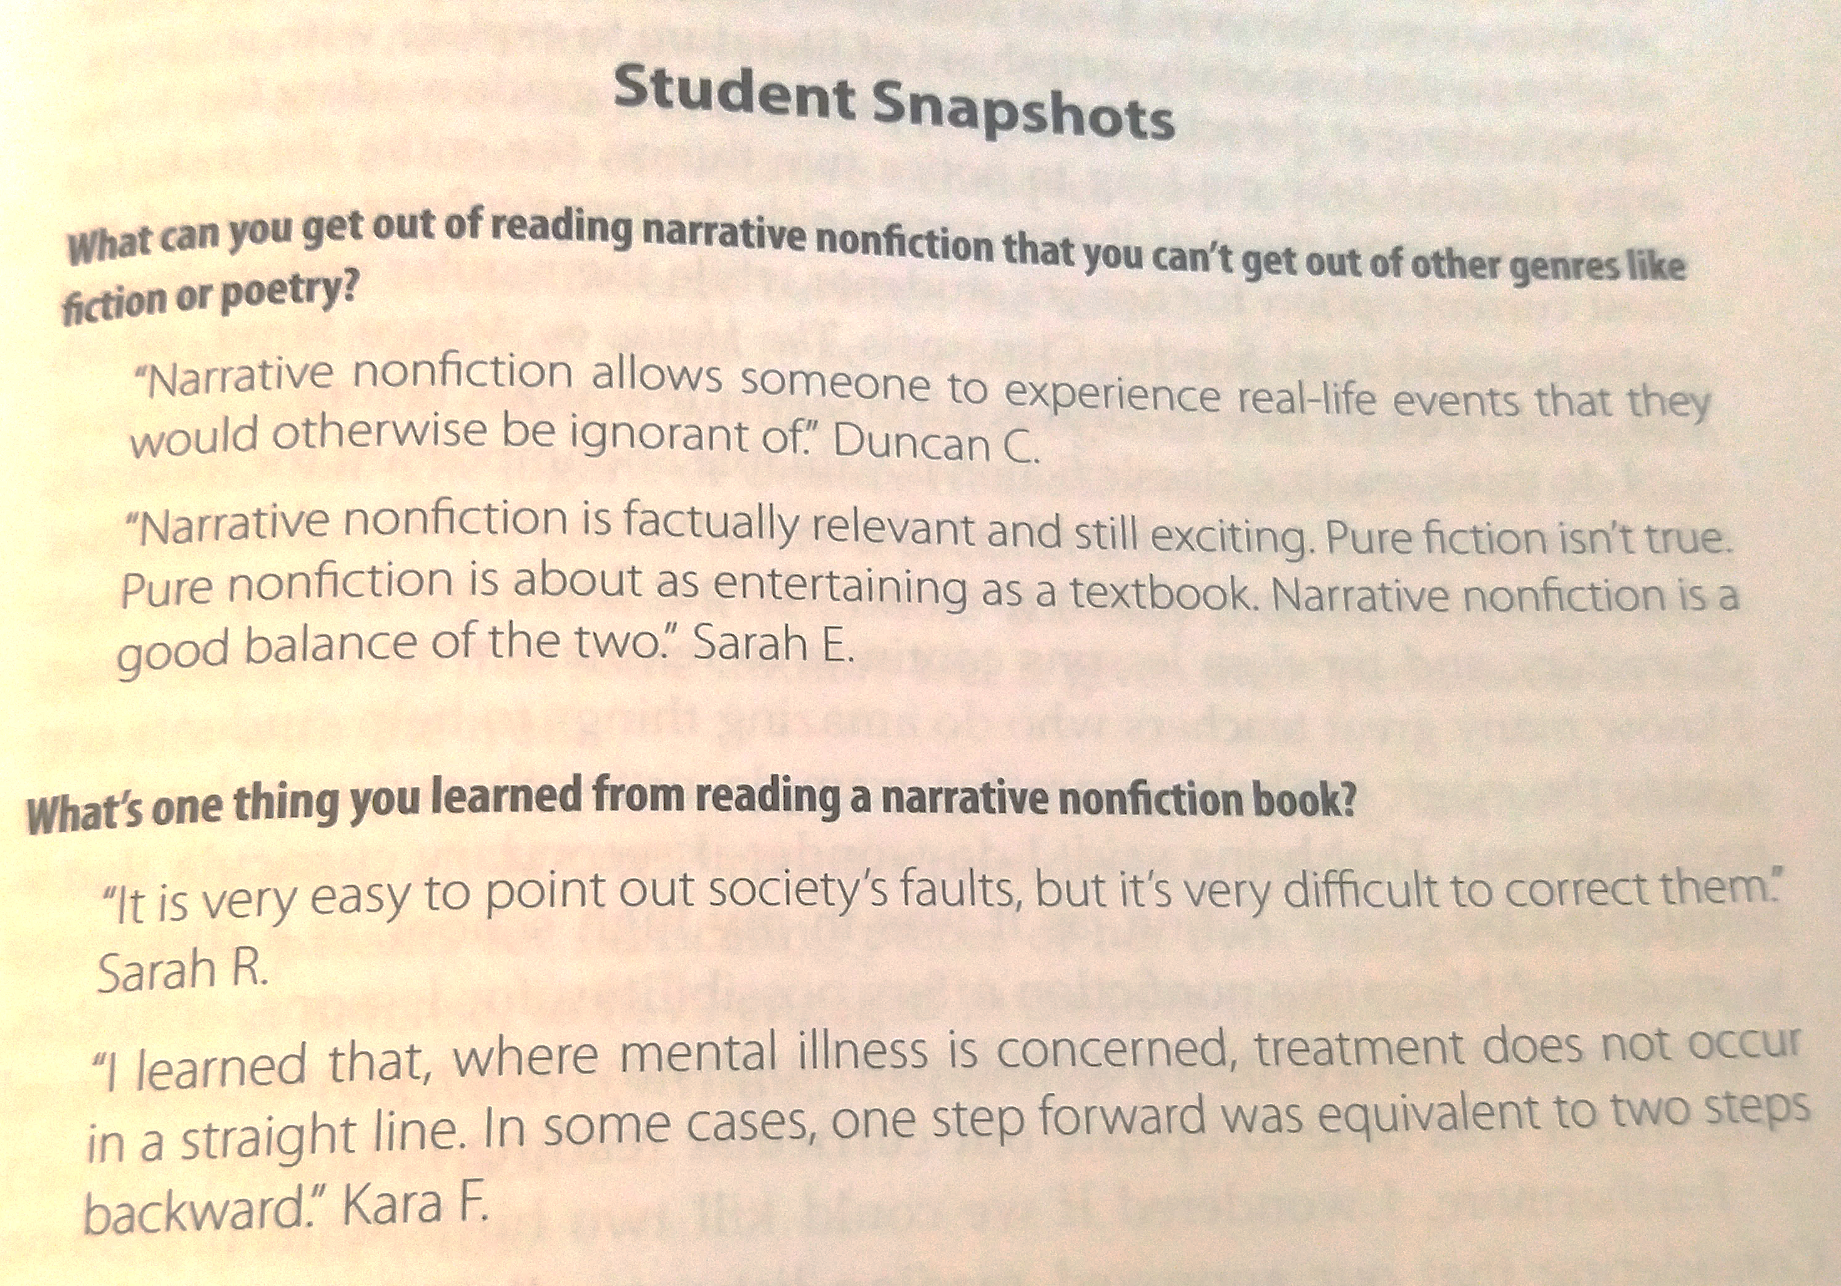
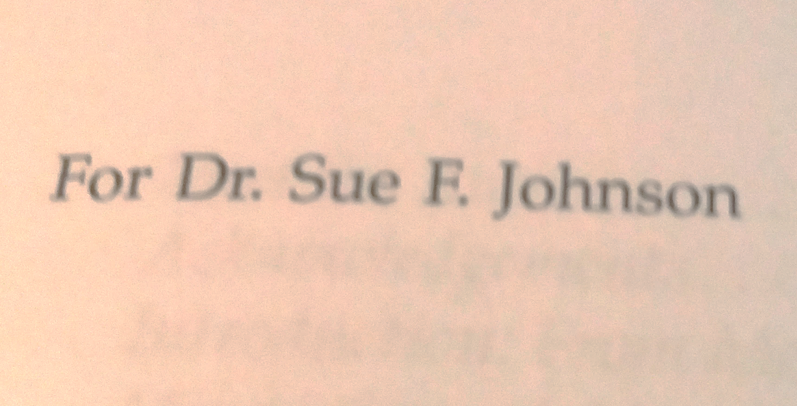

Slide 25
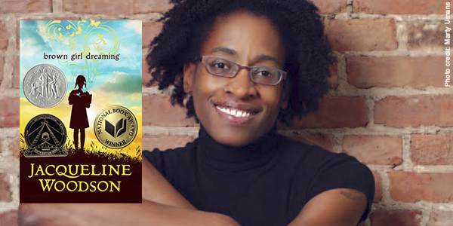
Jacqueline Woodson- Brown Girl Dreaming

Slide 26
Interested in a copy of From Me to We?
20% Coupon Code at Routledge!!
PLUS
Some handouts and freebies!!
PLEASE VISIT:
Breathedeepandteach.com

